Slide 1

GSD 100 SOURCE HEAD
Maintenance Assembly Reference
IMPLANTER-Diffusion Department
Prepared By: SAMUEL 山姆爾 SaSPAREDOC.08

Slide 2
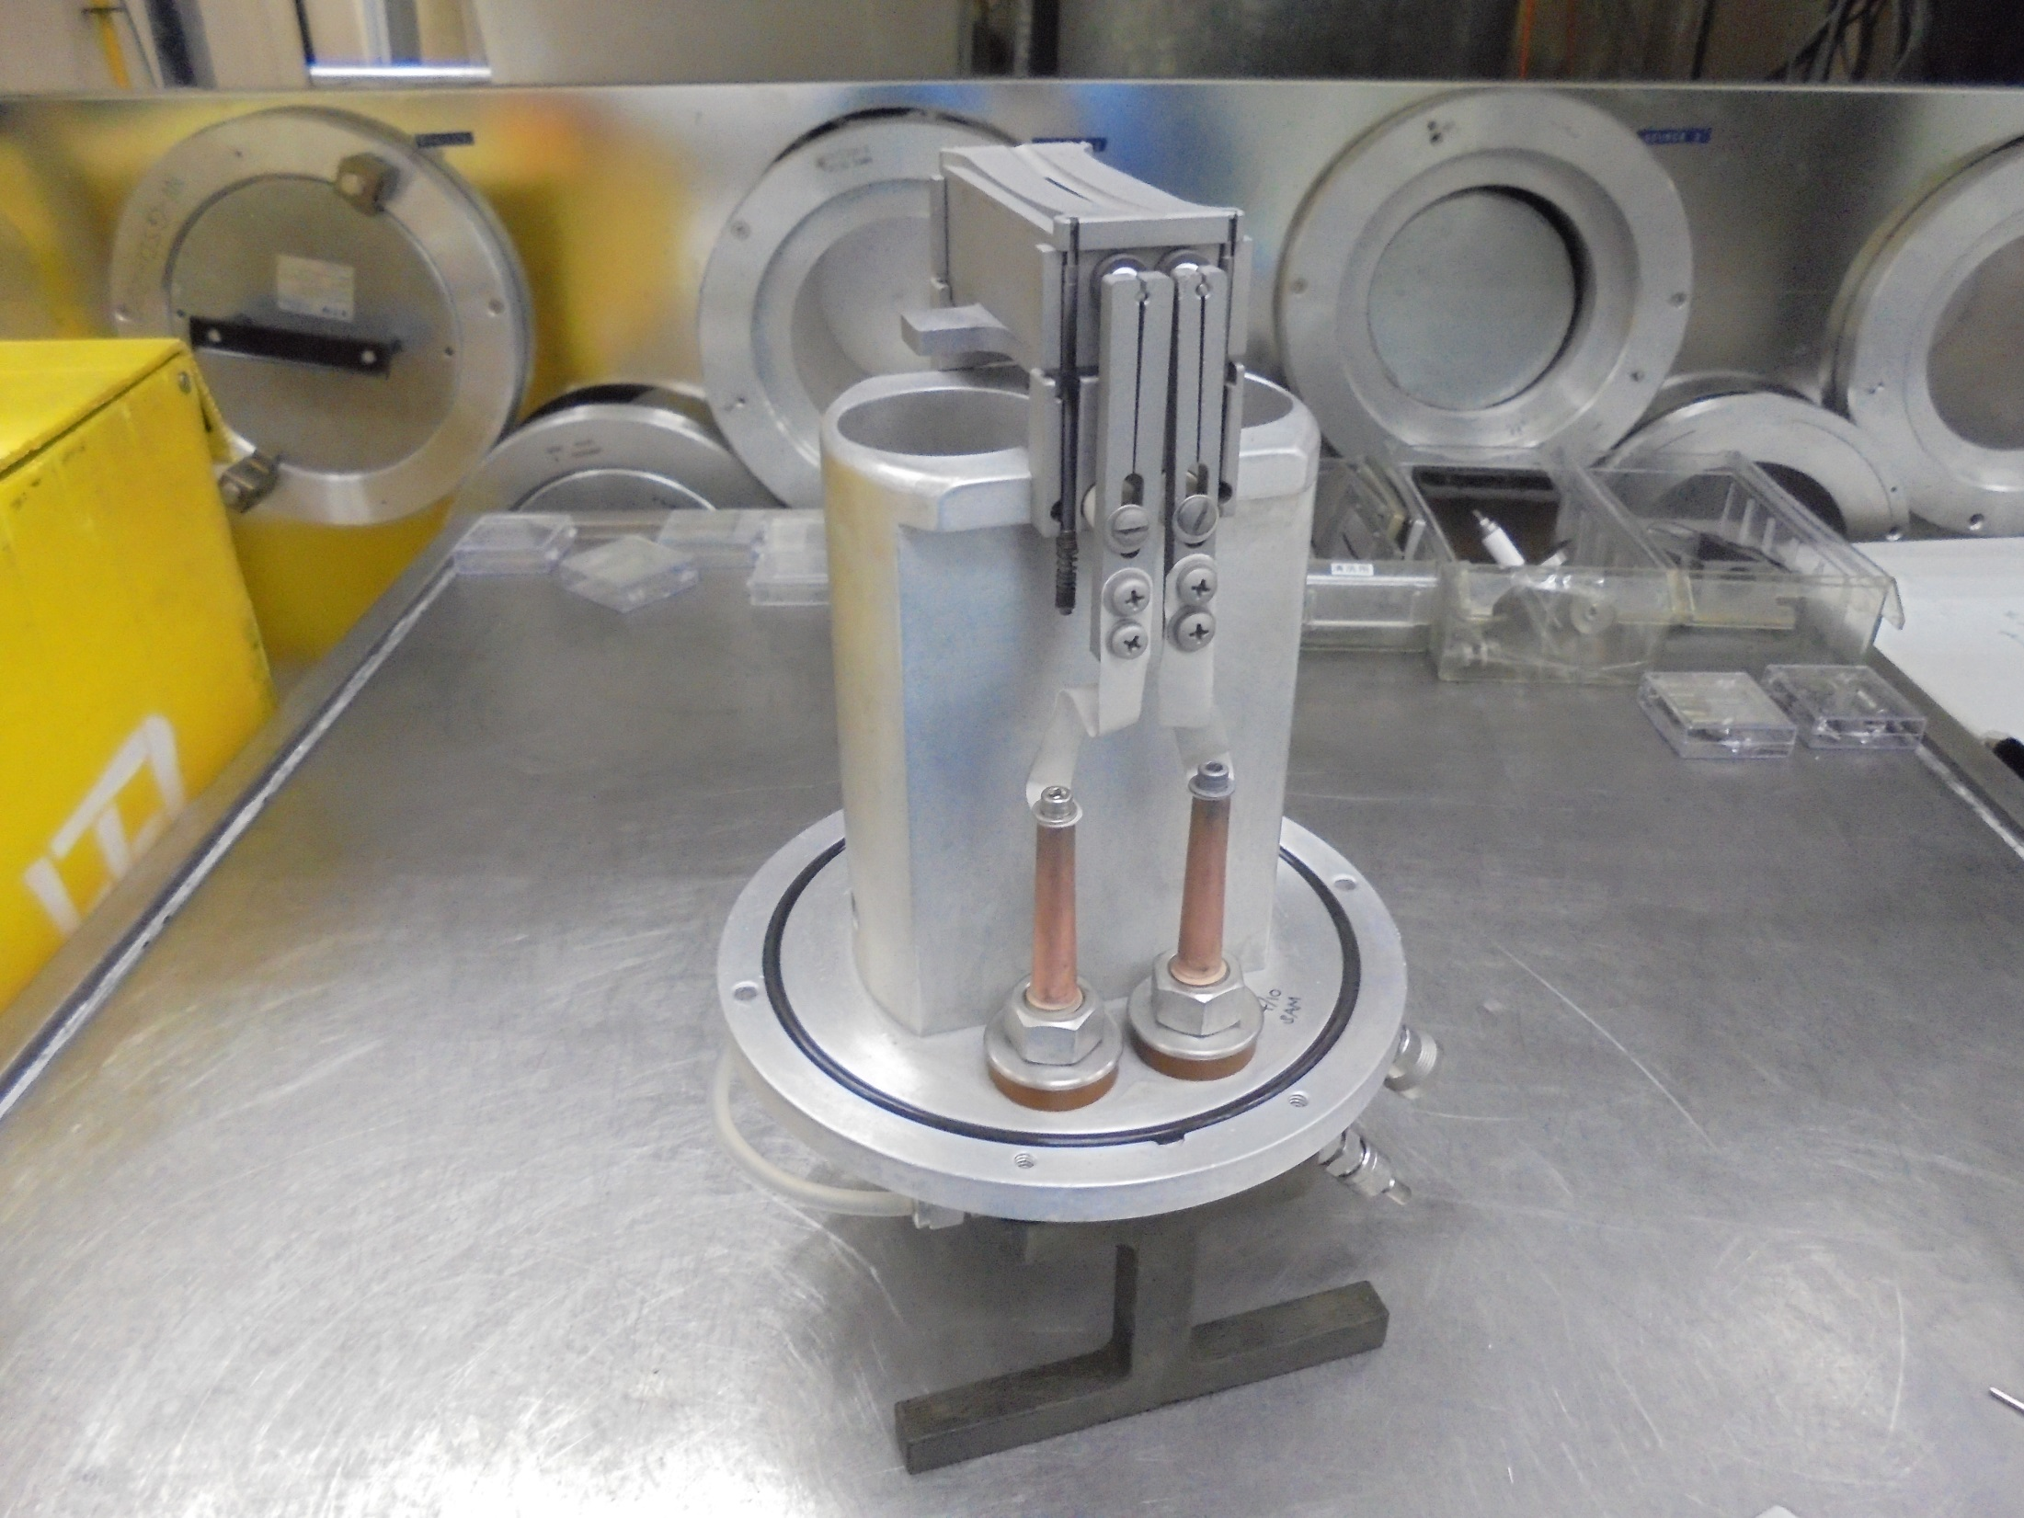
GSD 100 SOURCE HEAD

Slide 3
COMSUMABLE PARTS

Slide 4
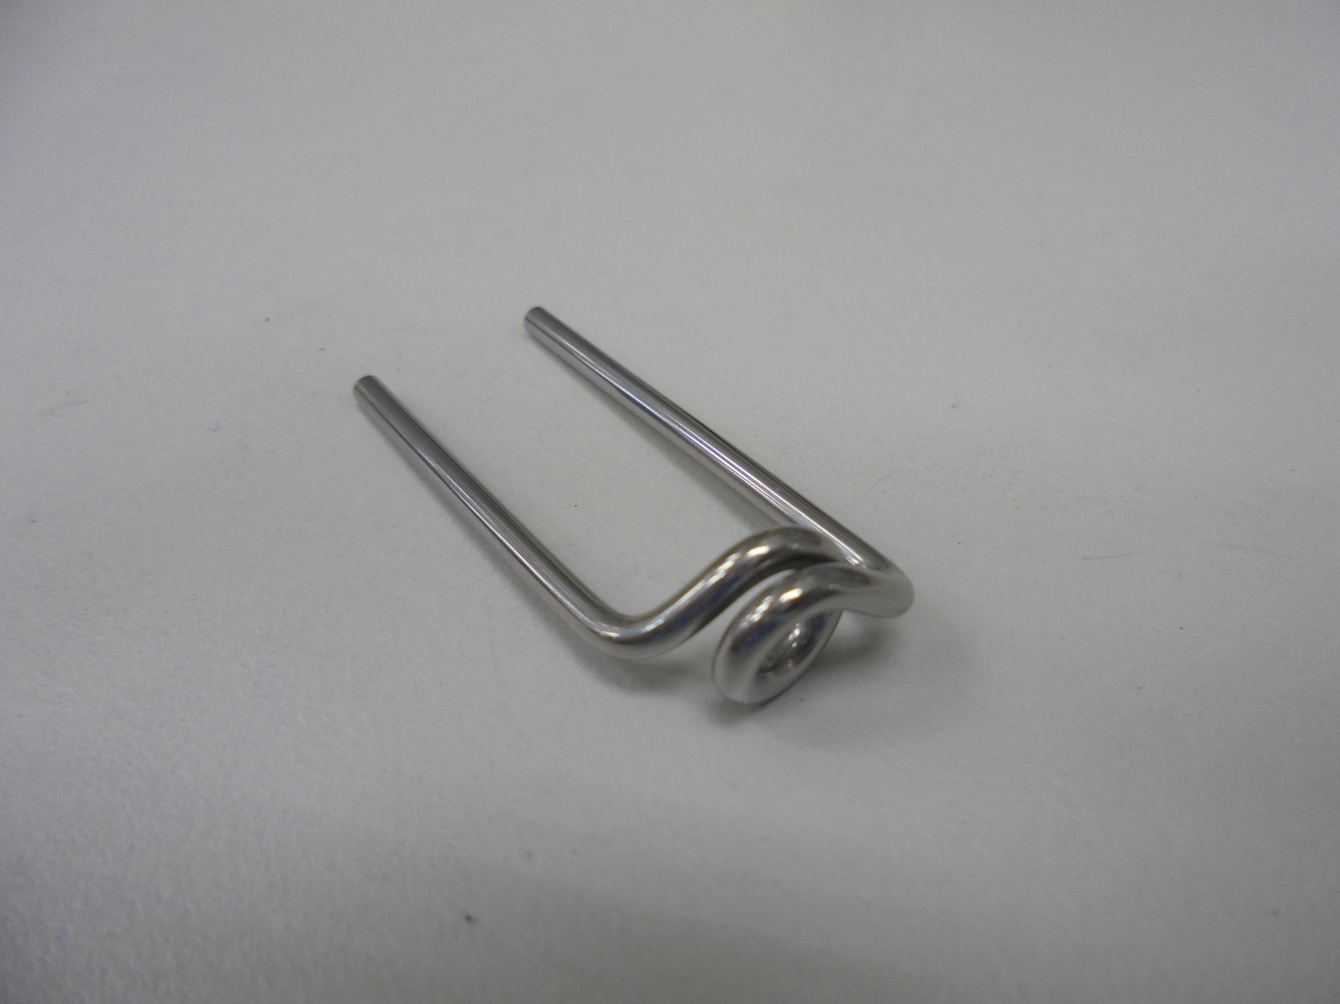
FILAMENT

Slide 5
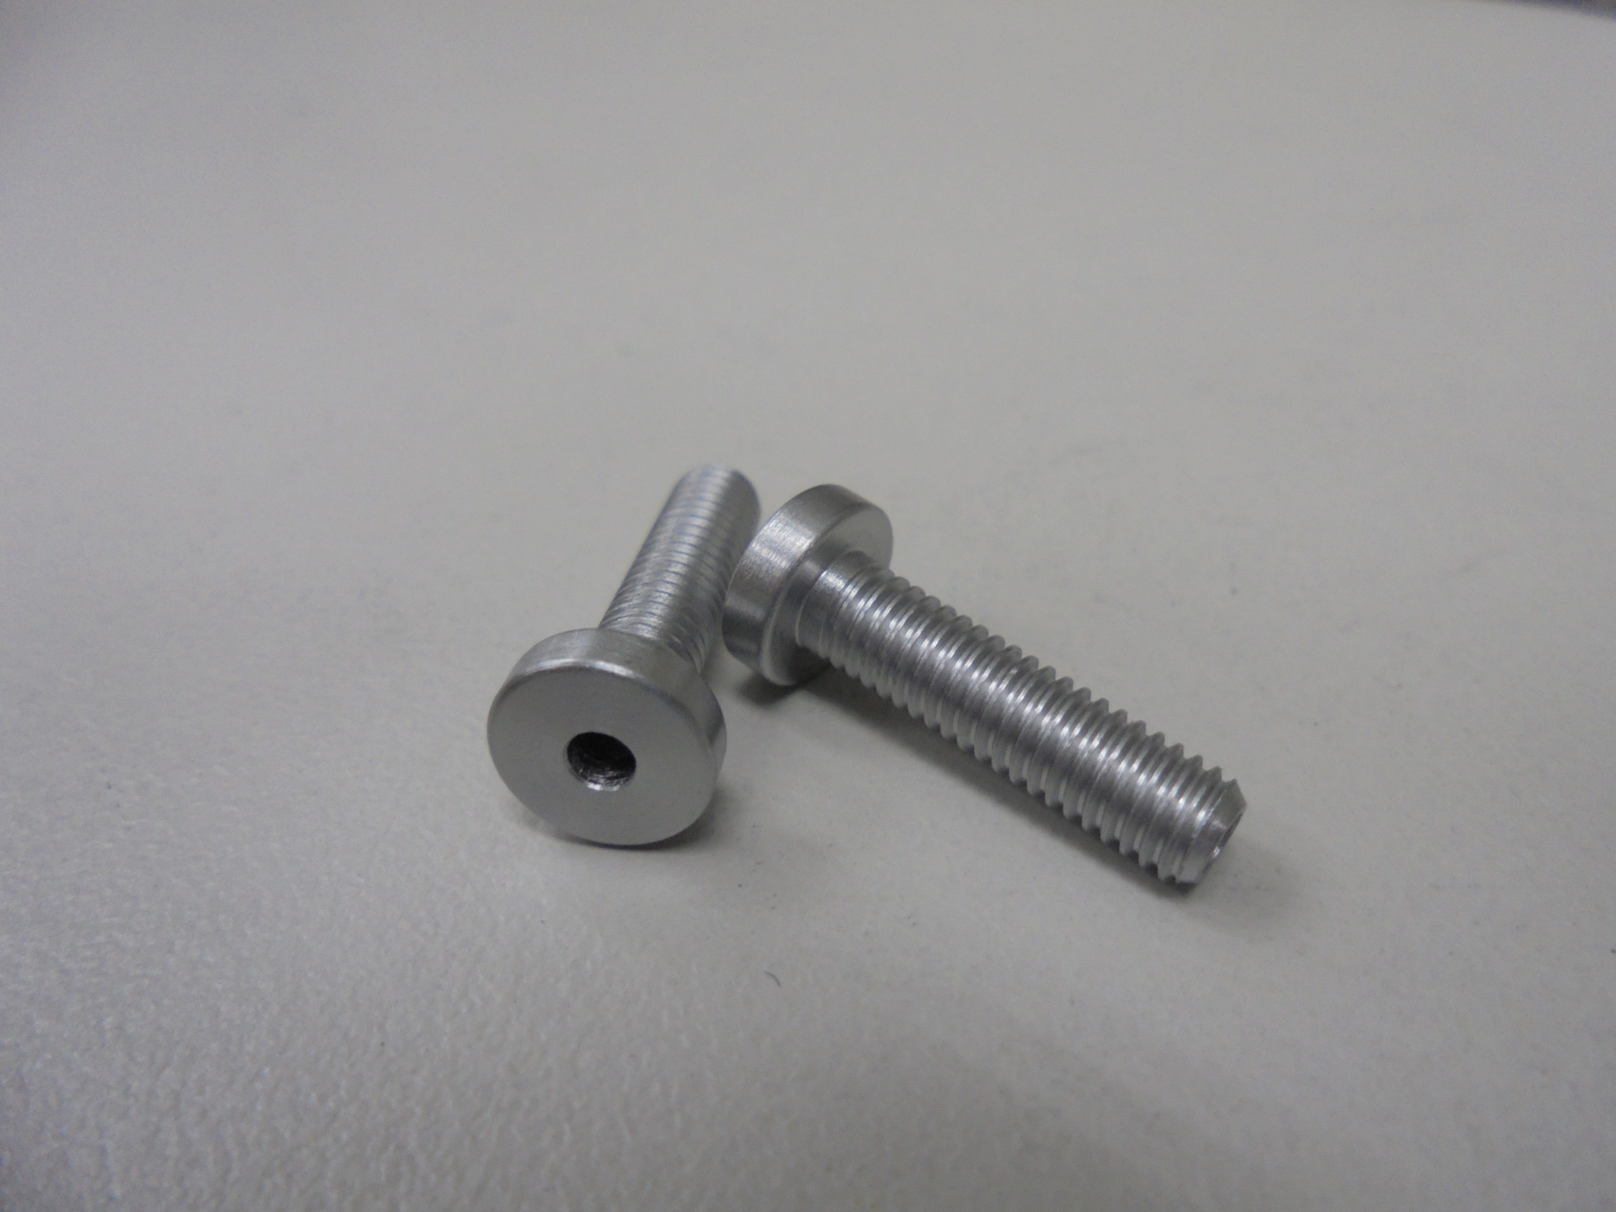
FILAMENT SCREW

Slide 6
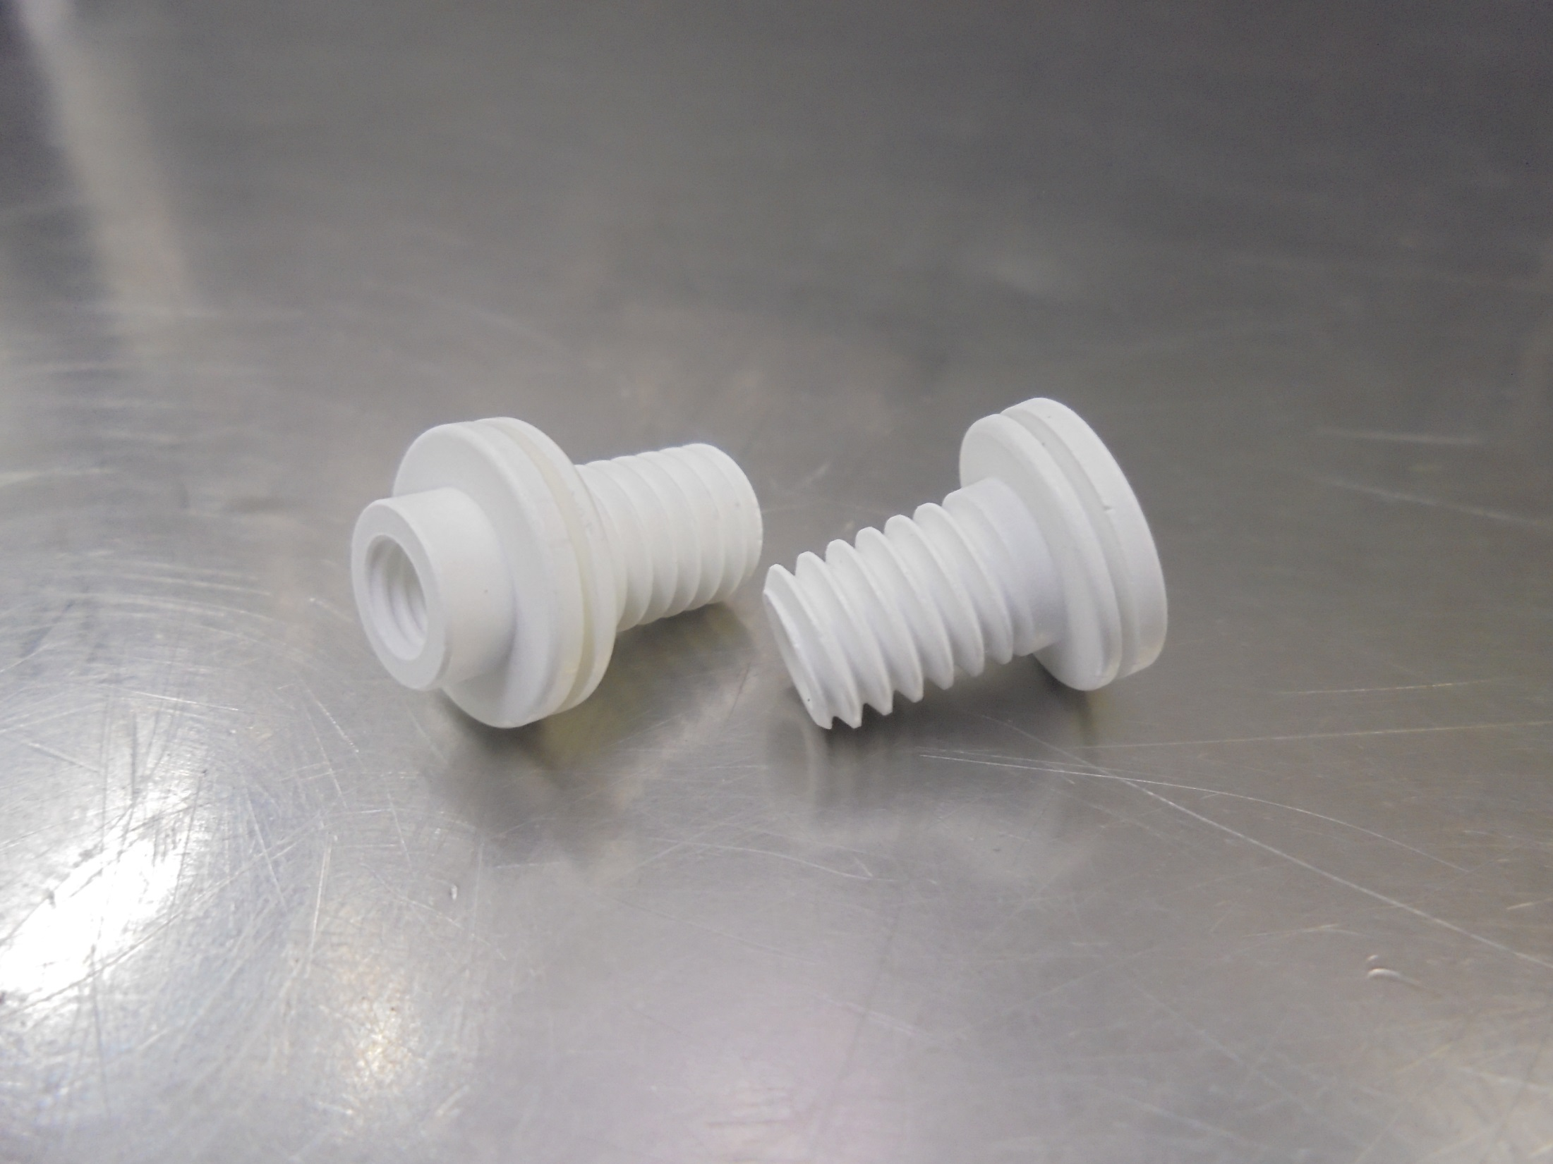
FILAMENT SCREW INSULATOR

Slide 7
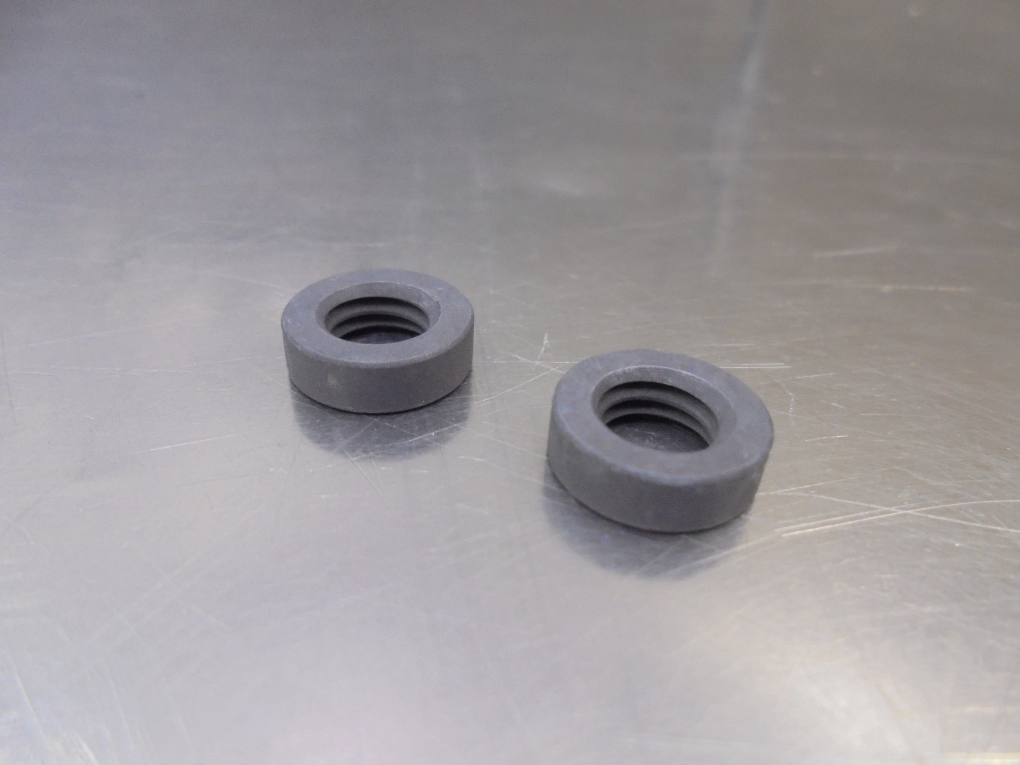
INSULATOR NUT [GRAPHITE]

Slide 8
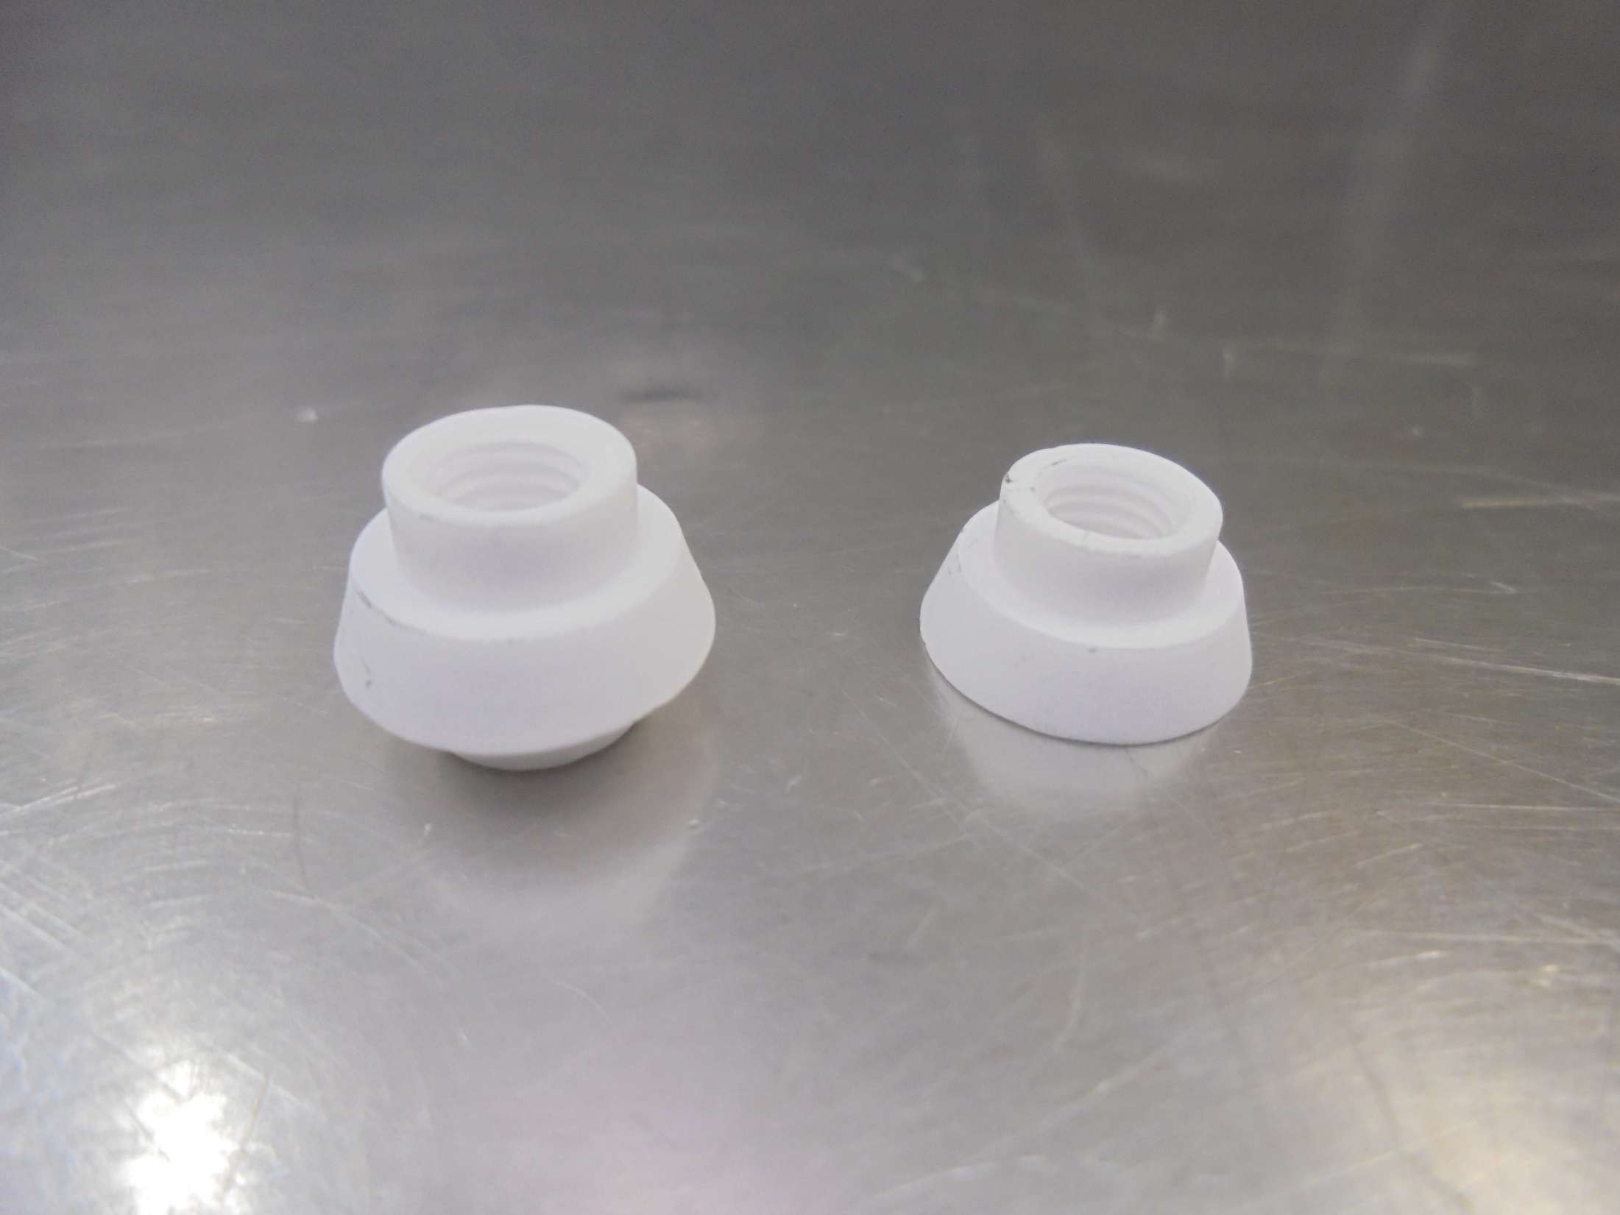
REPELLER INSULATOR [CERAMIC]

Slide 9
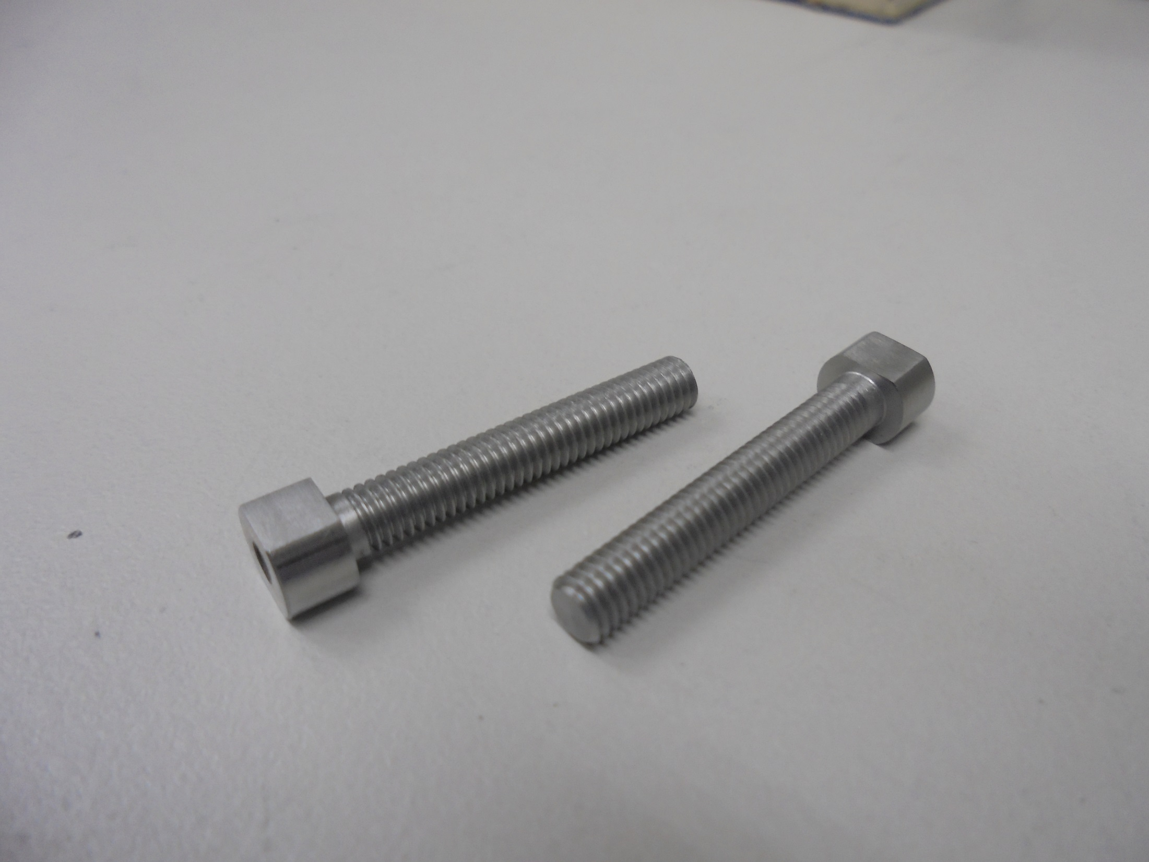
REPELLER SCREW

Slide 10
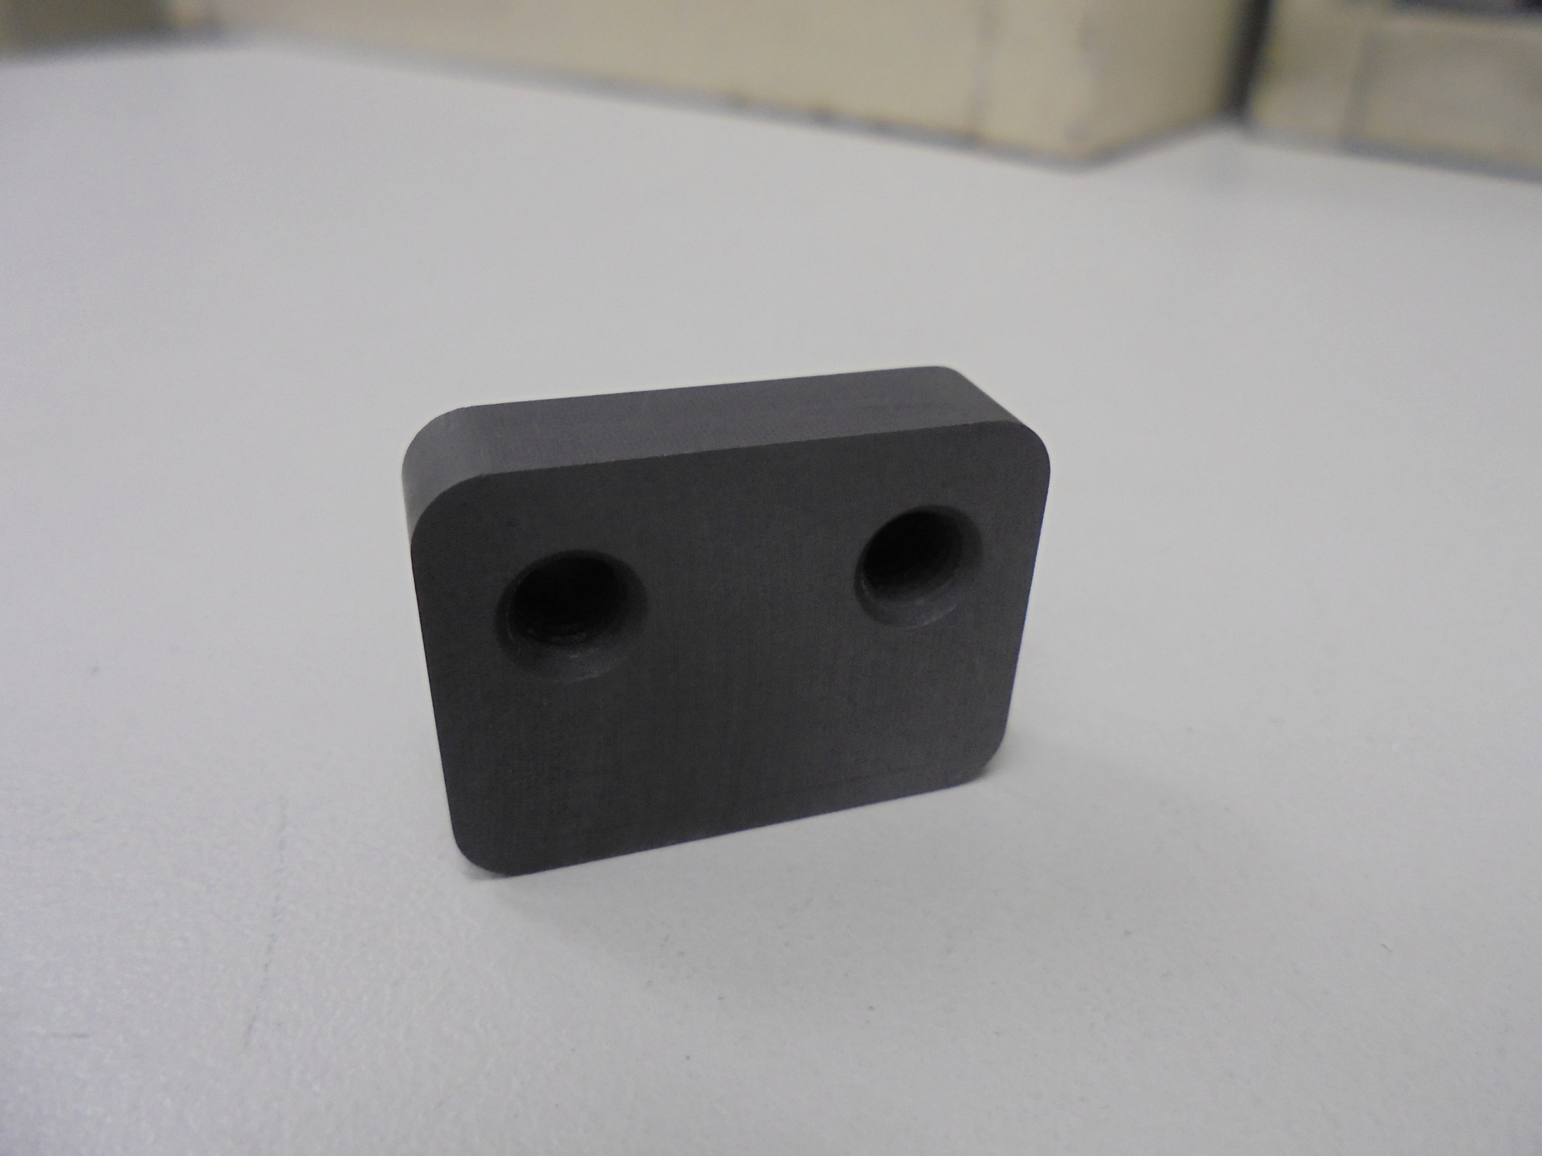
REPELLER PLATE [GRAPHITE]

Slide 11
ASSEMBLY

Slide 12
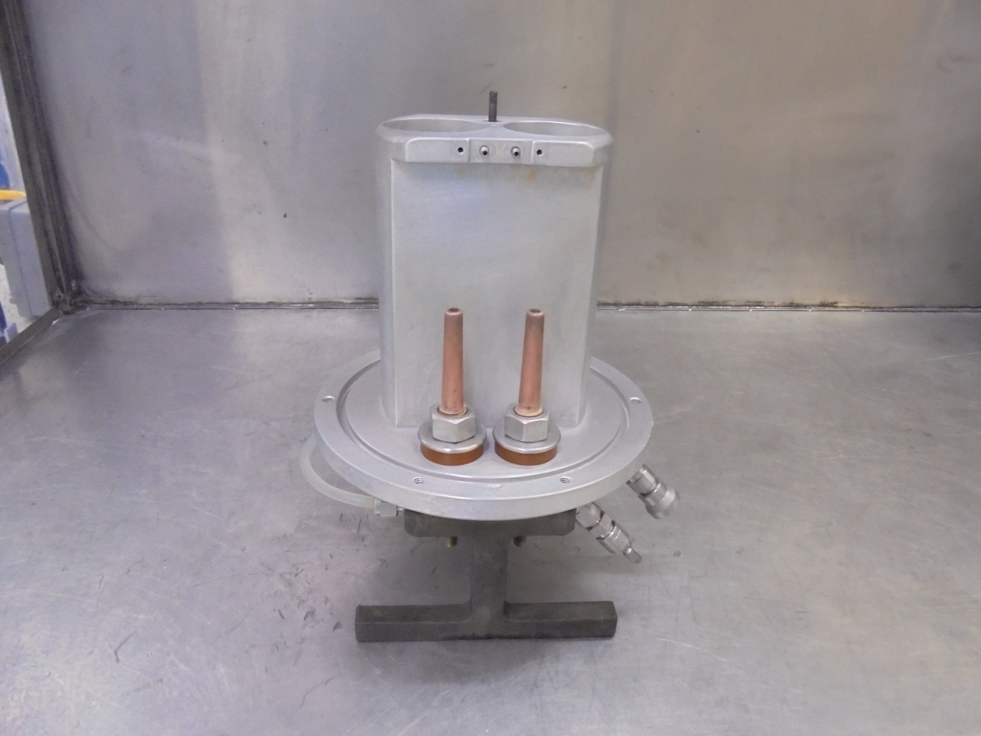
SOURCE BODY

Slide 13
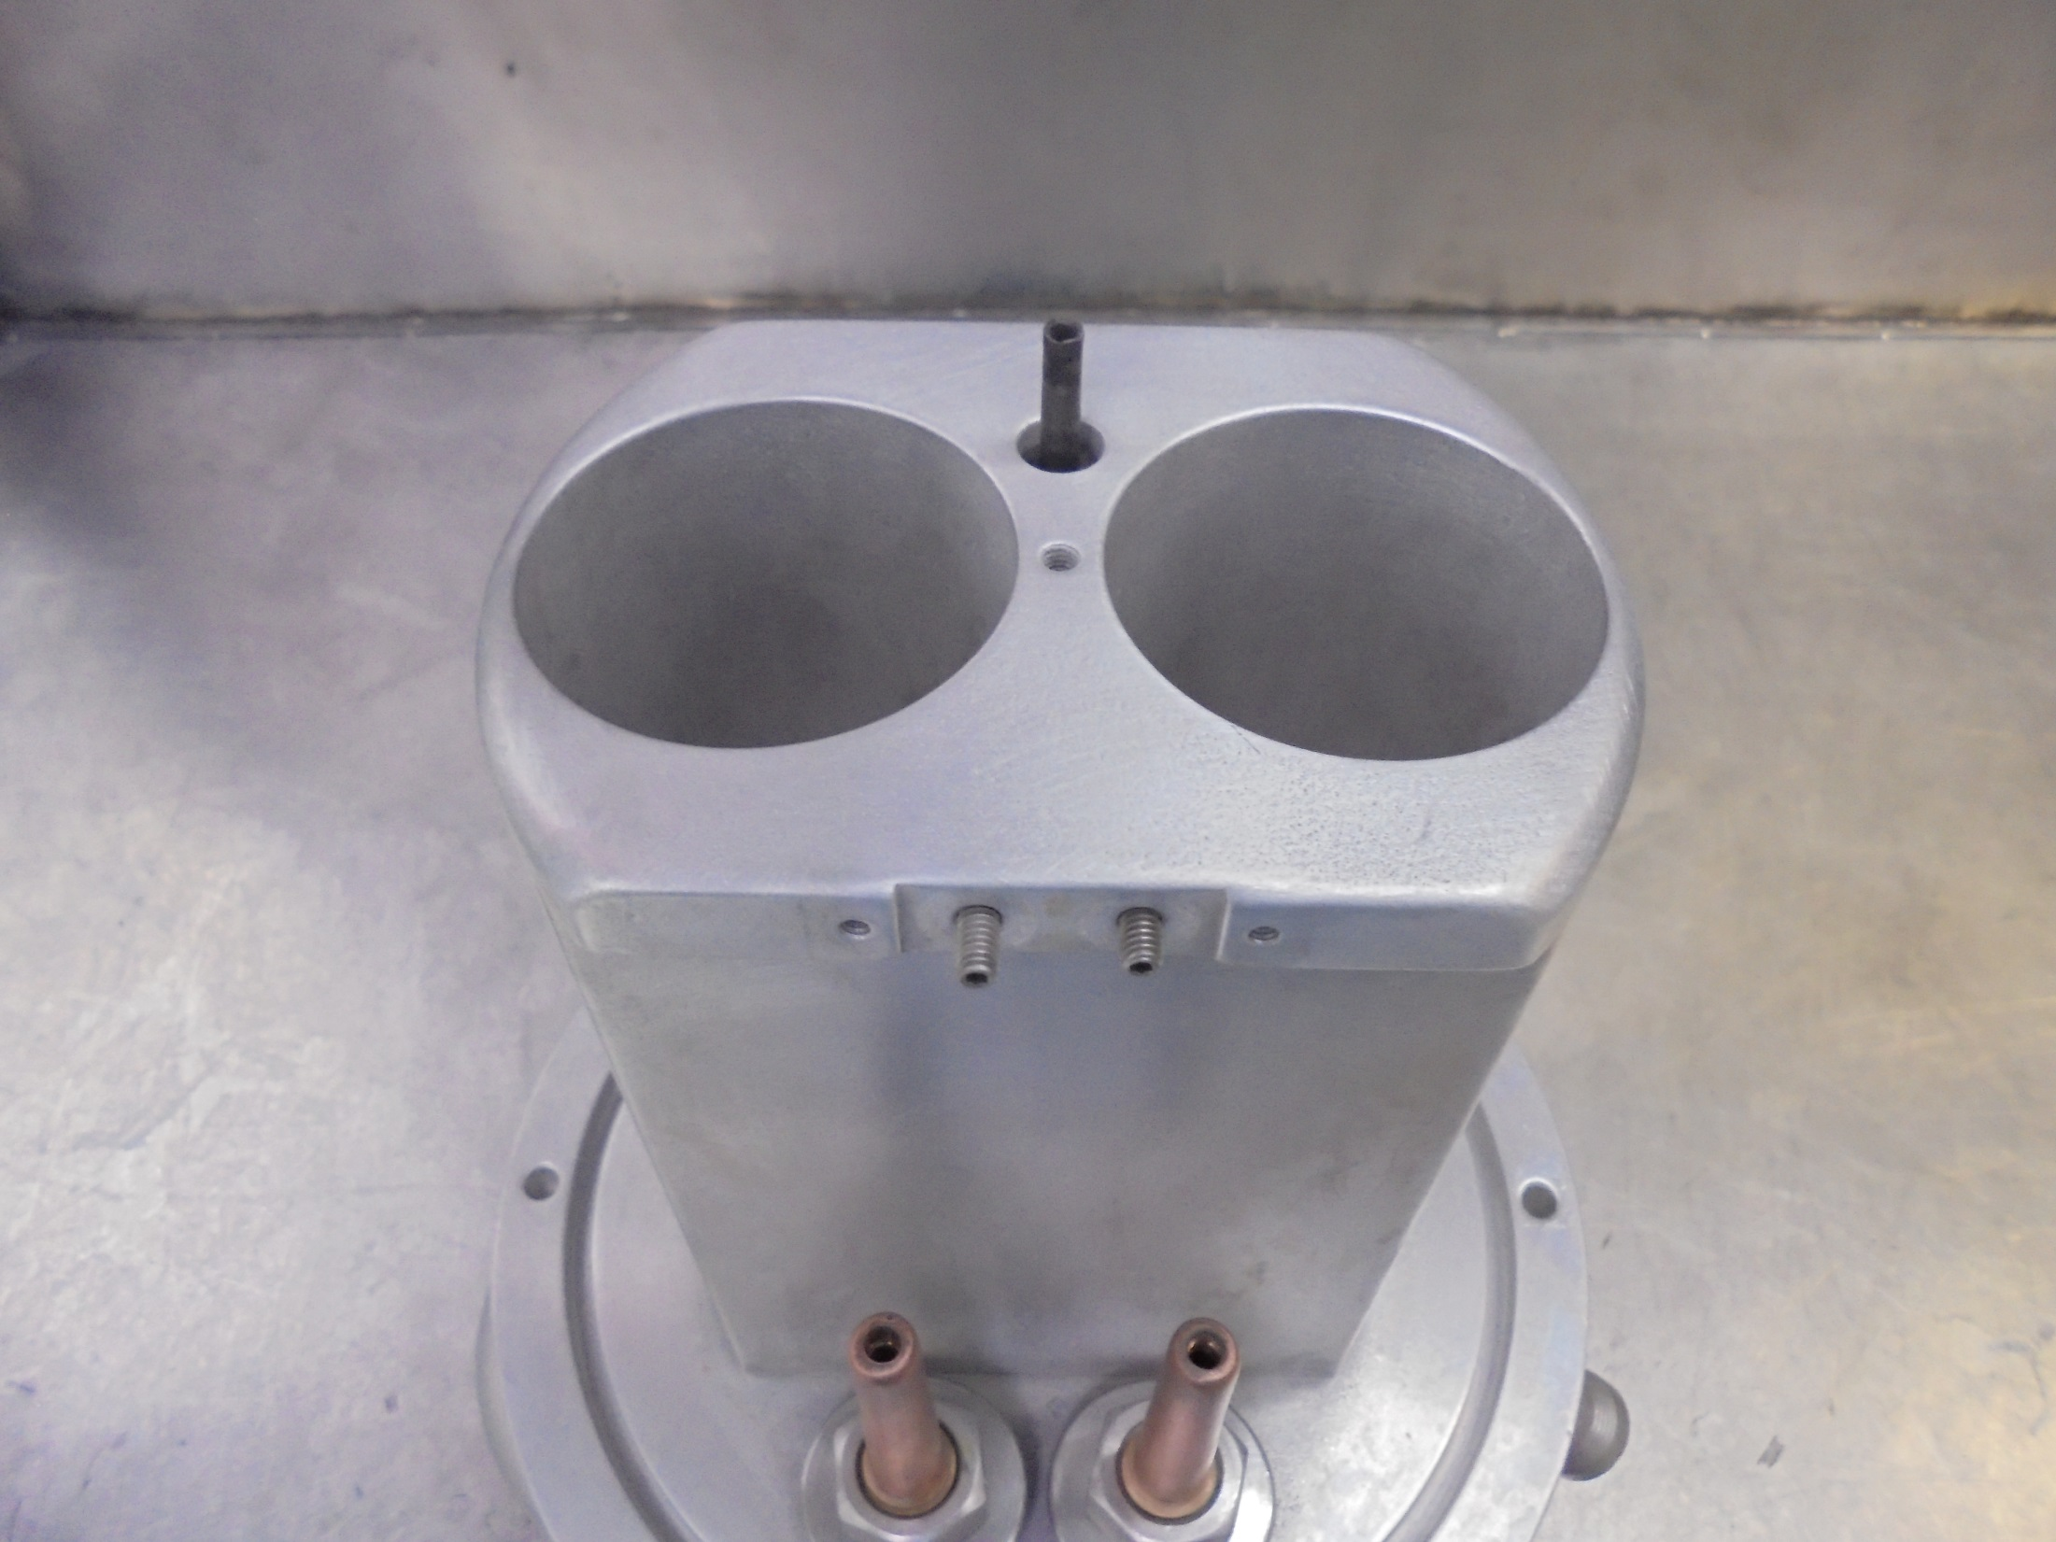
GAS LINE
MOUNTING STAGE [TOP]

Slide 14
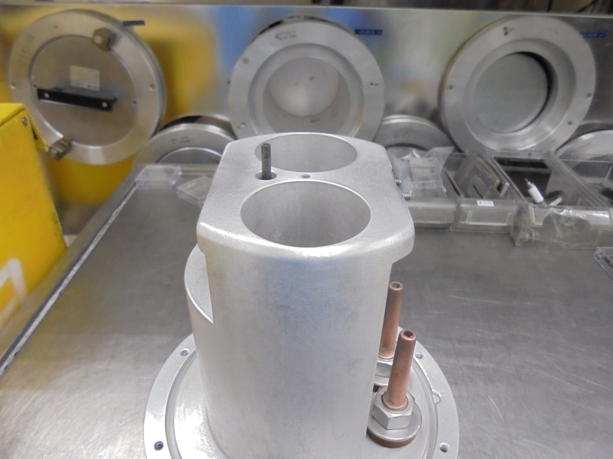
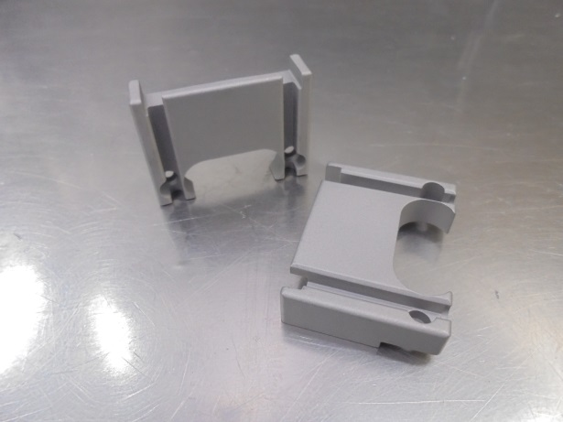
*Installing ARC CHAMBER
Mounting Support
ARC CHAMBER SUPPORT

Slide 15
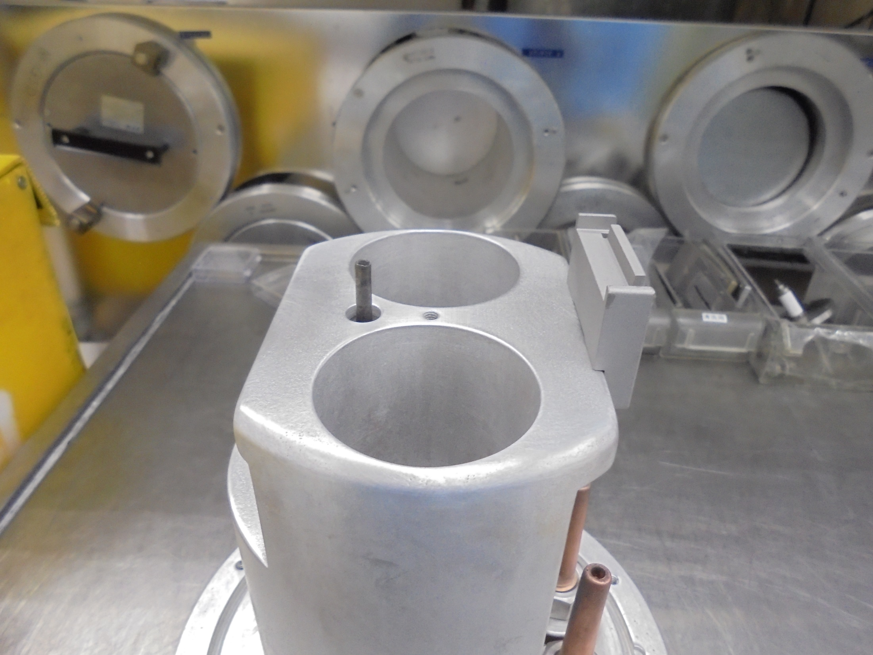
*Install FILAMENT END Support

Slide 16
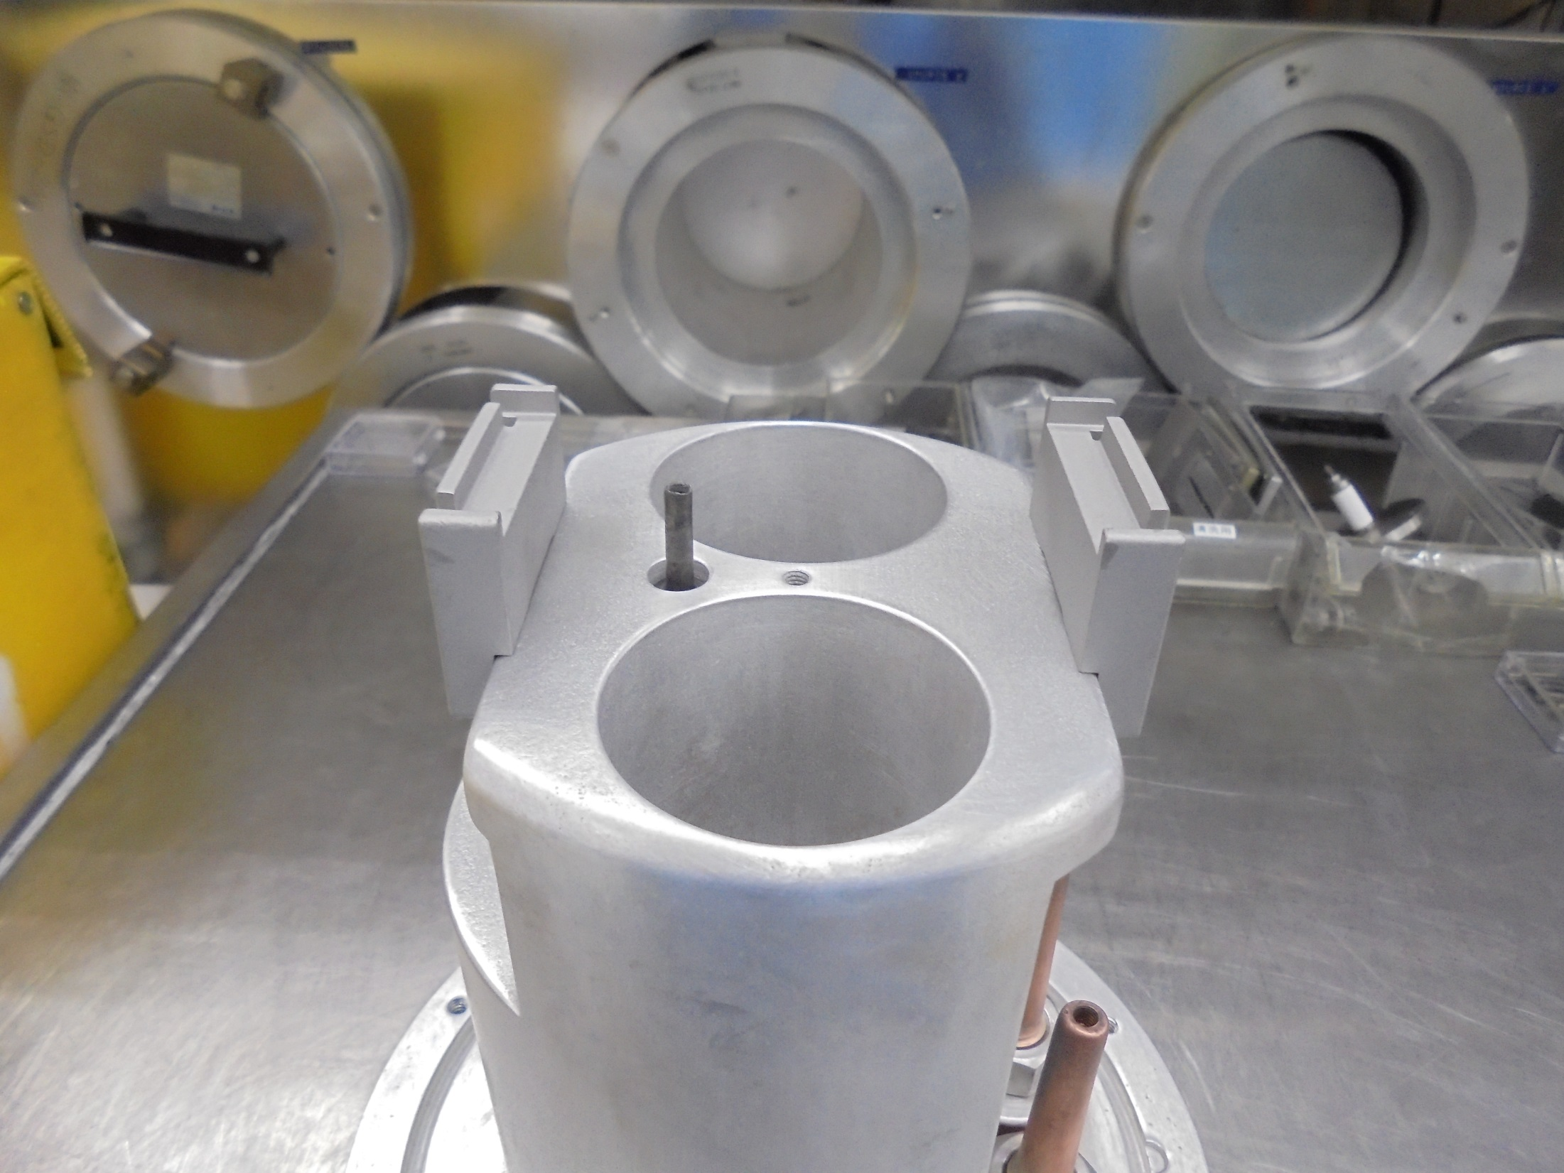
*Install REPELLER END Support

Slide 17
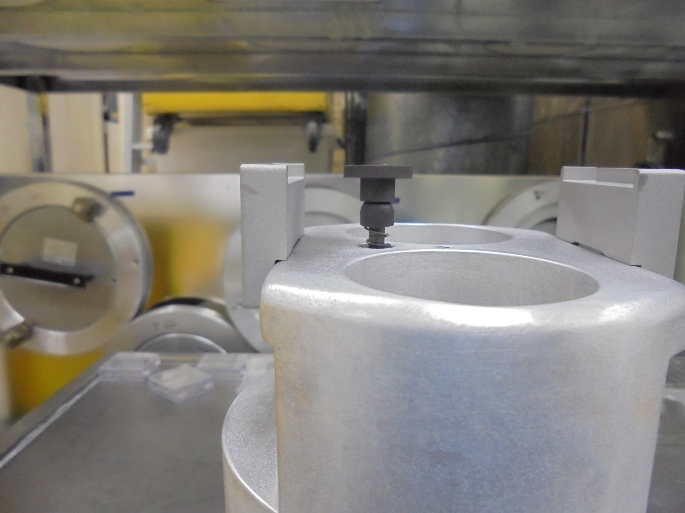
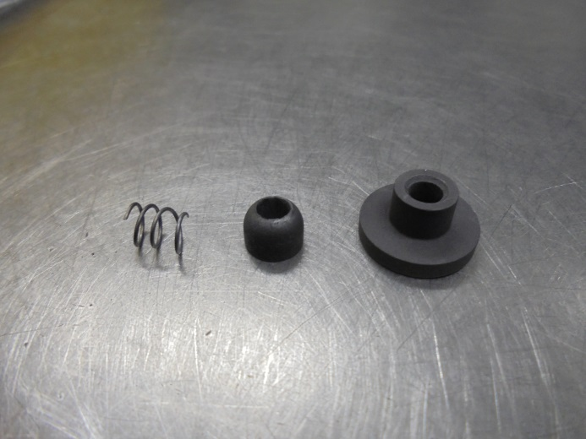
Install Here!...
Spring.Ball.SKT Joint

Slide 18
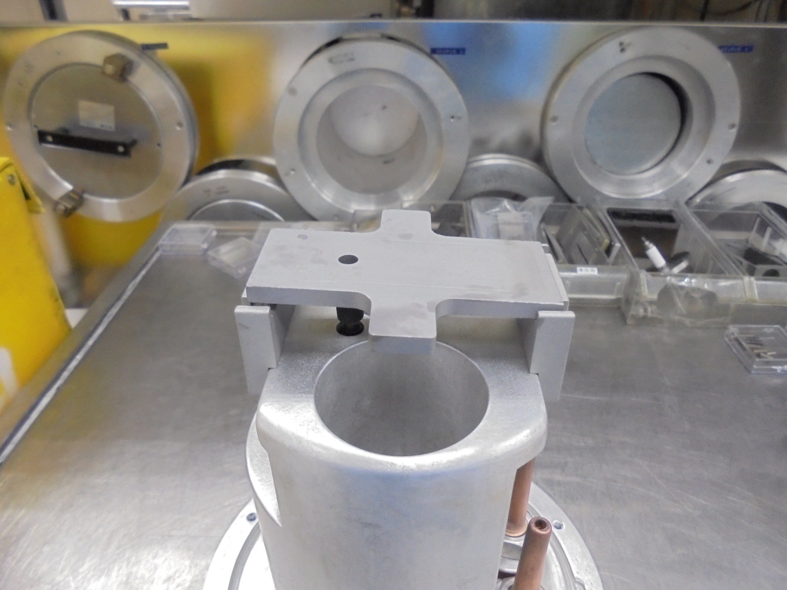
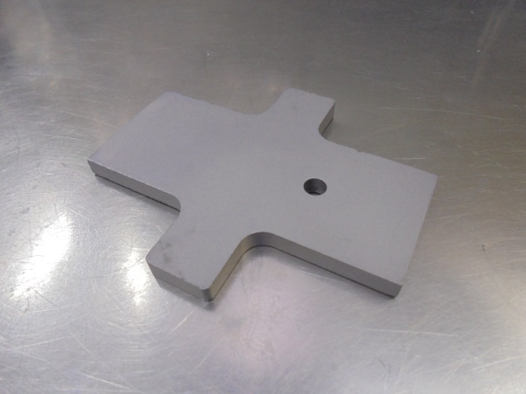
Gas Hole
*Install ARC CHAMBER Base Plate…

Slide 19
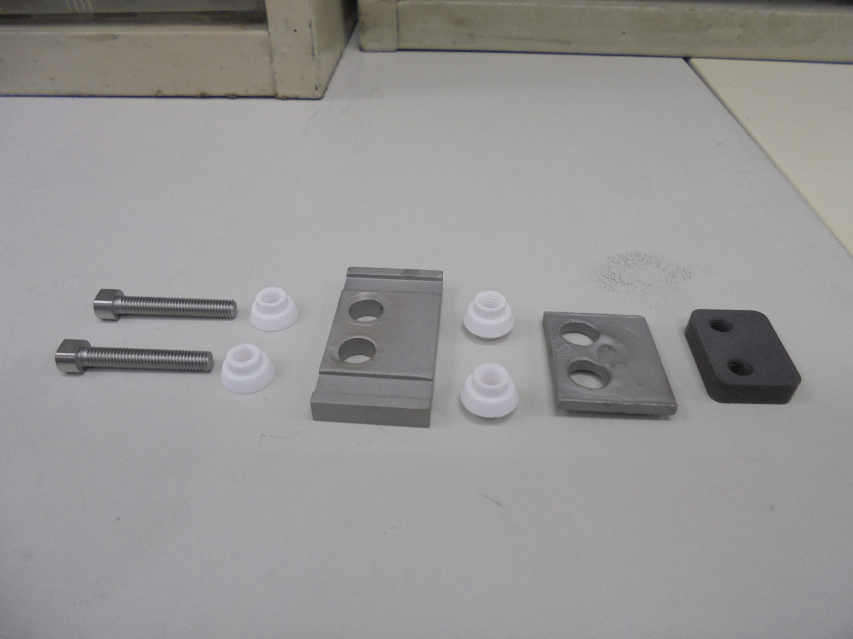
Assemble The Following REPELLER END Components:

Slide 20
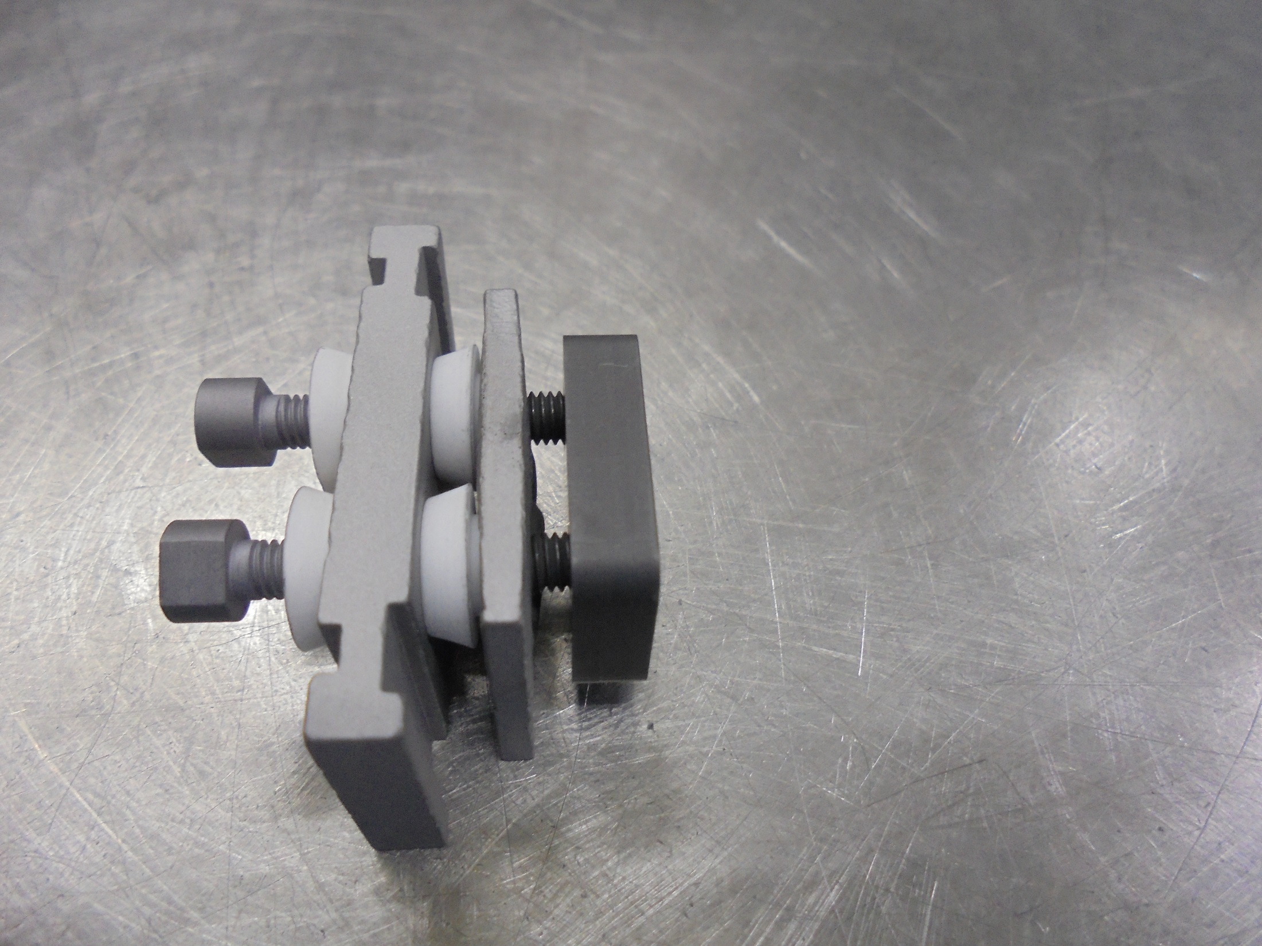
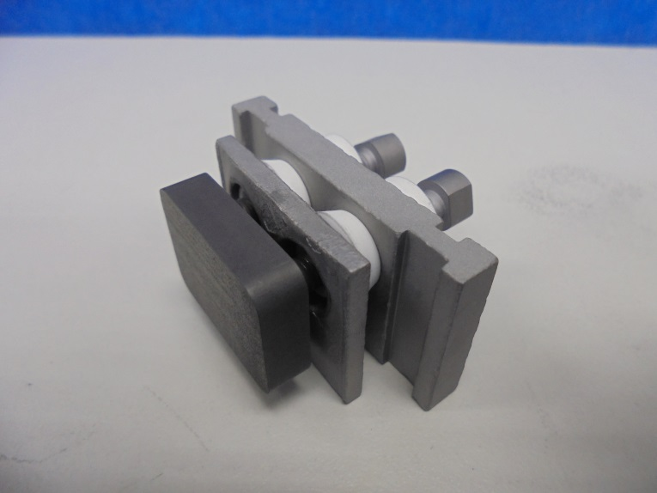
REPELLER END Assembly

Slide 21
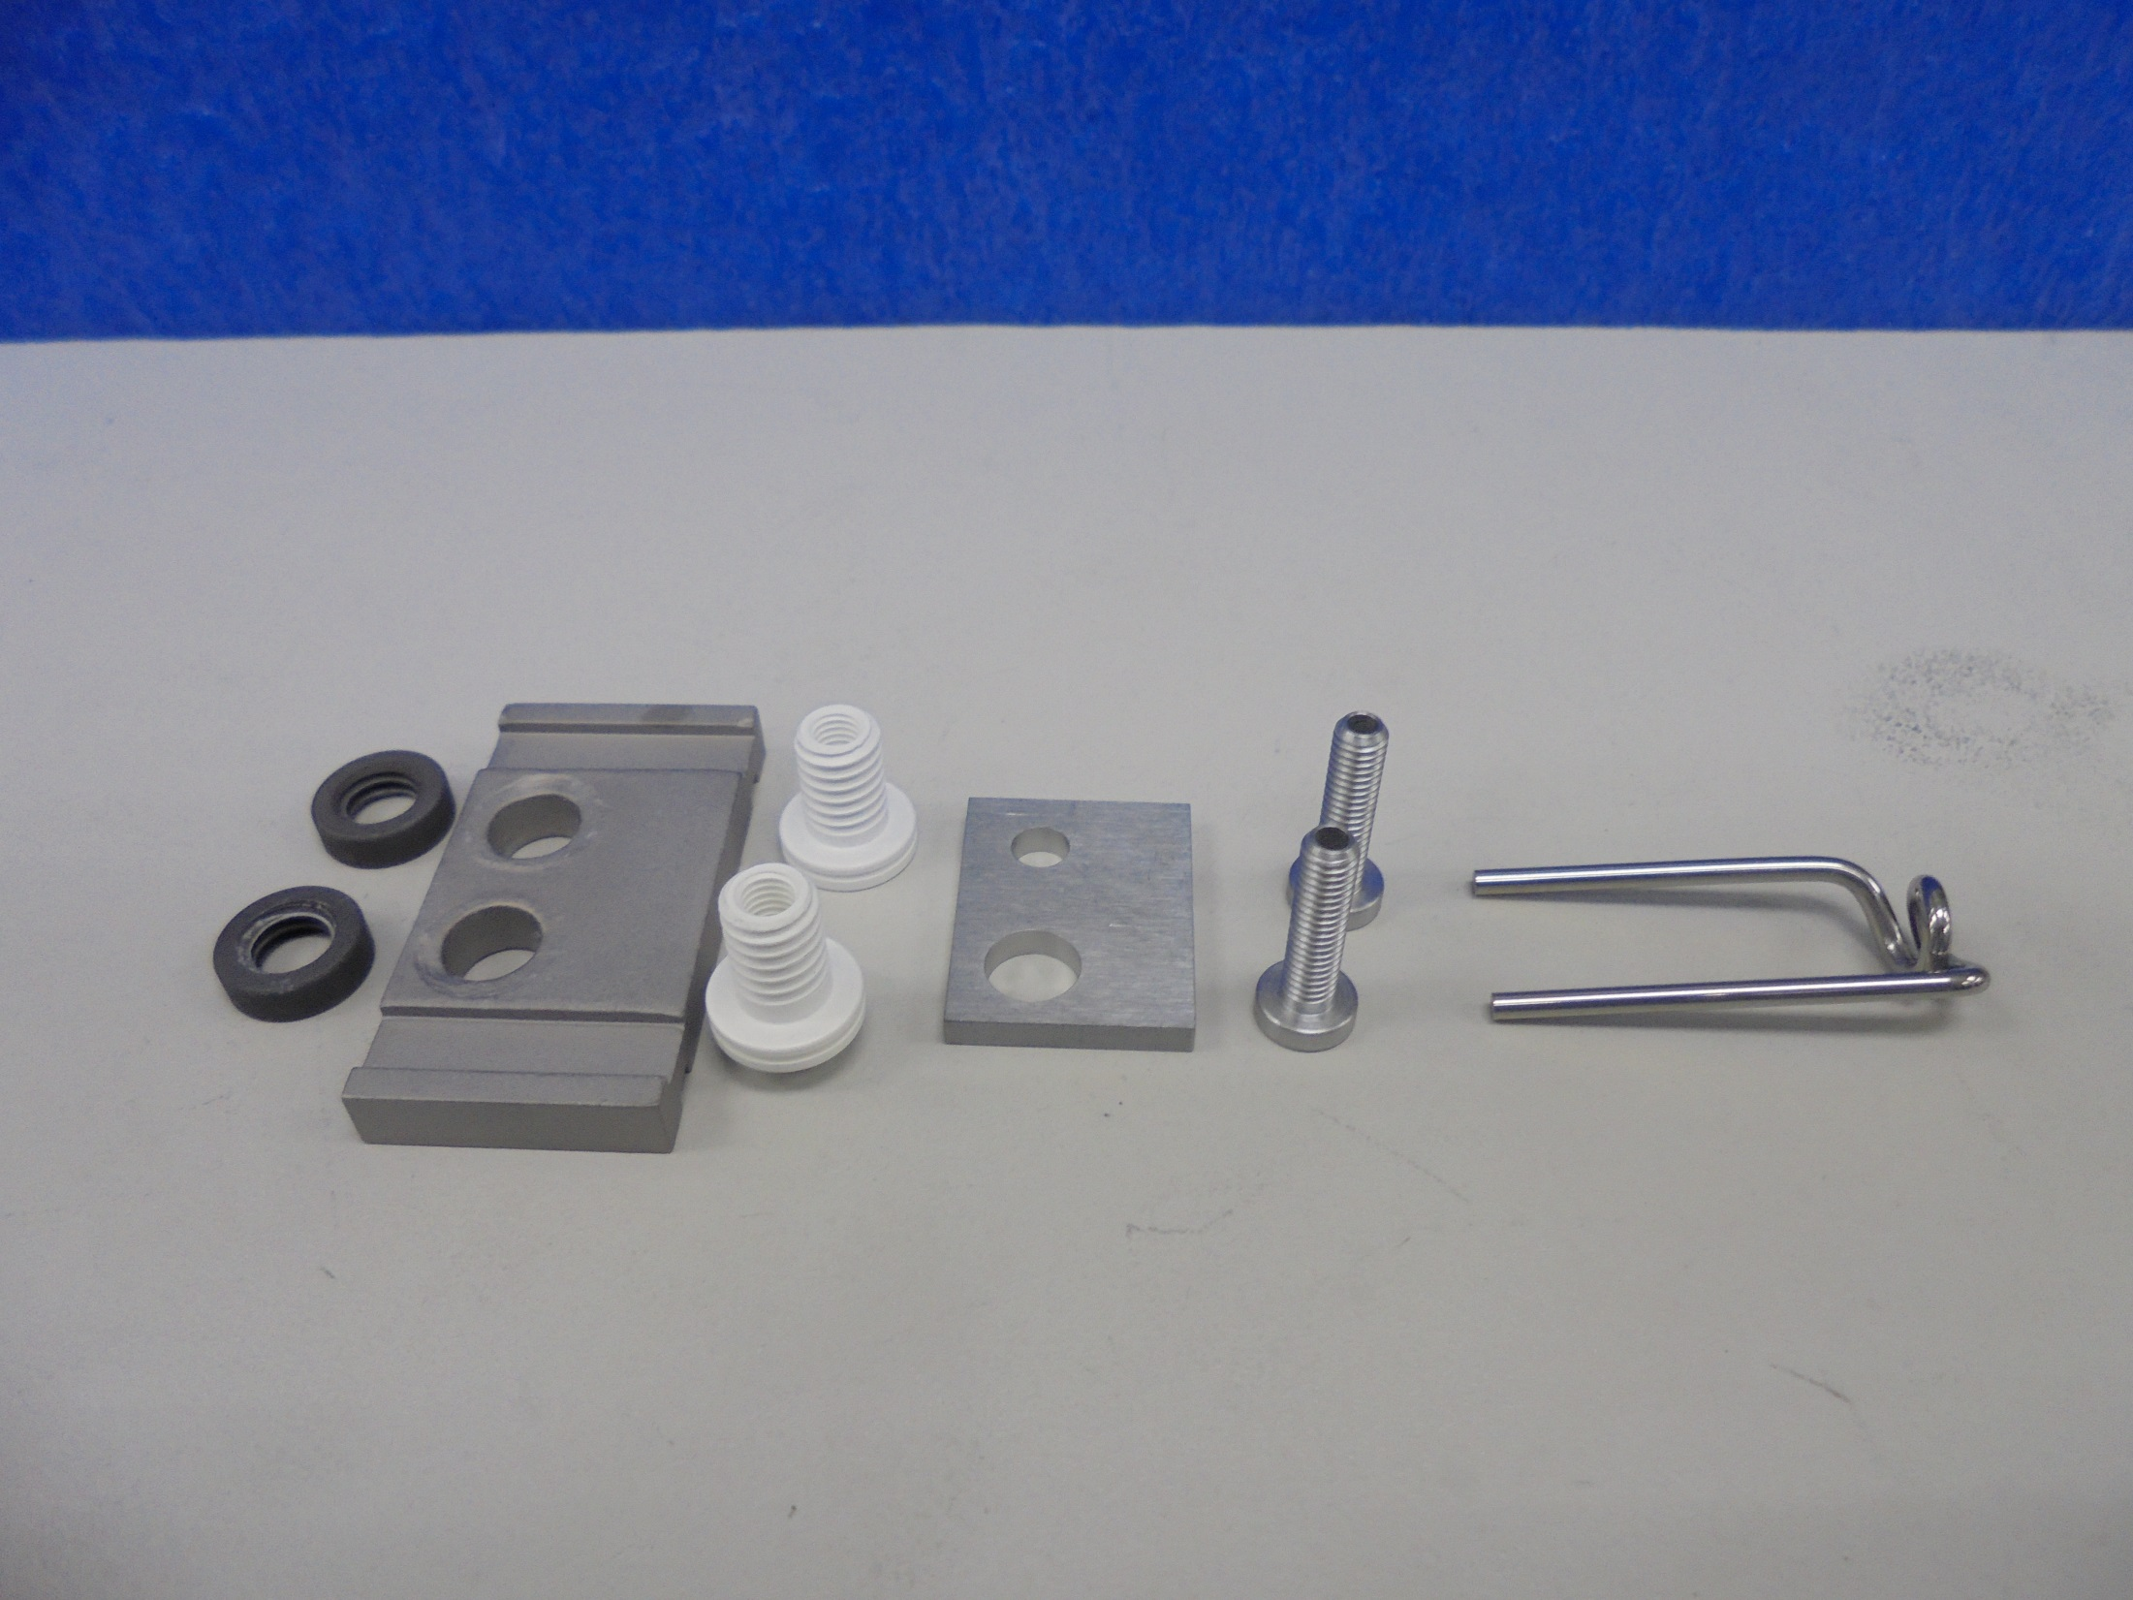
Assemble The Following FILAMENT END Components:

Slide 22
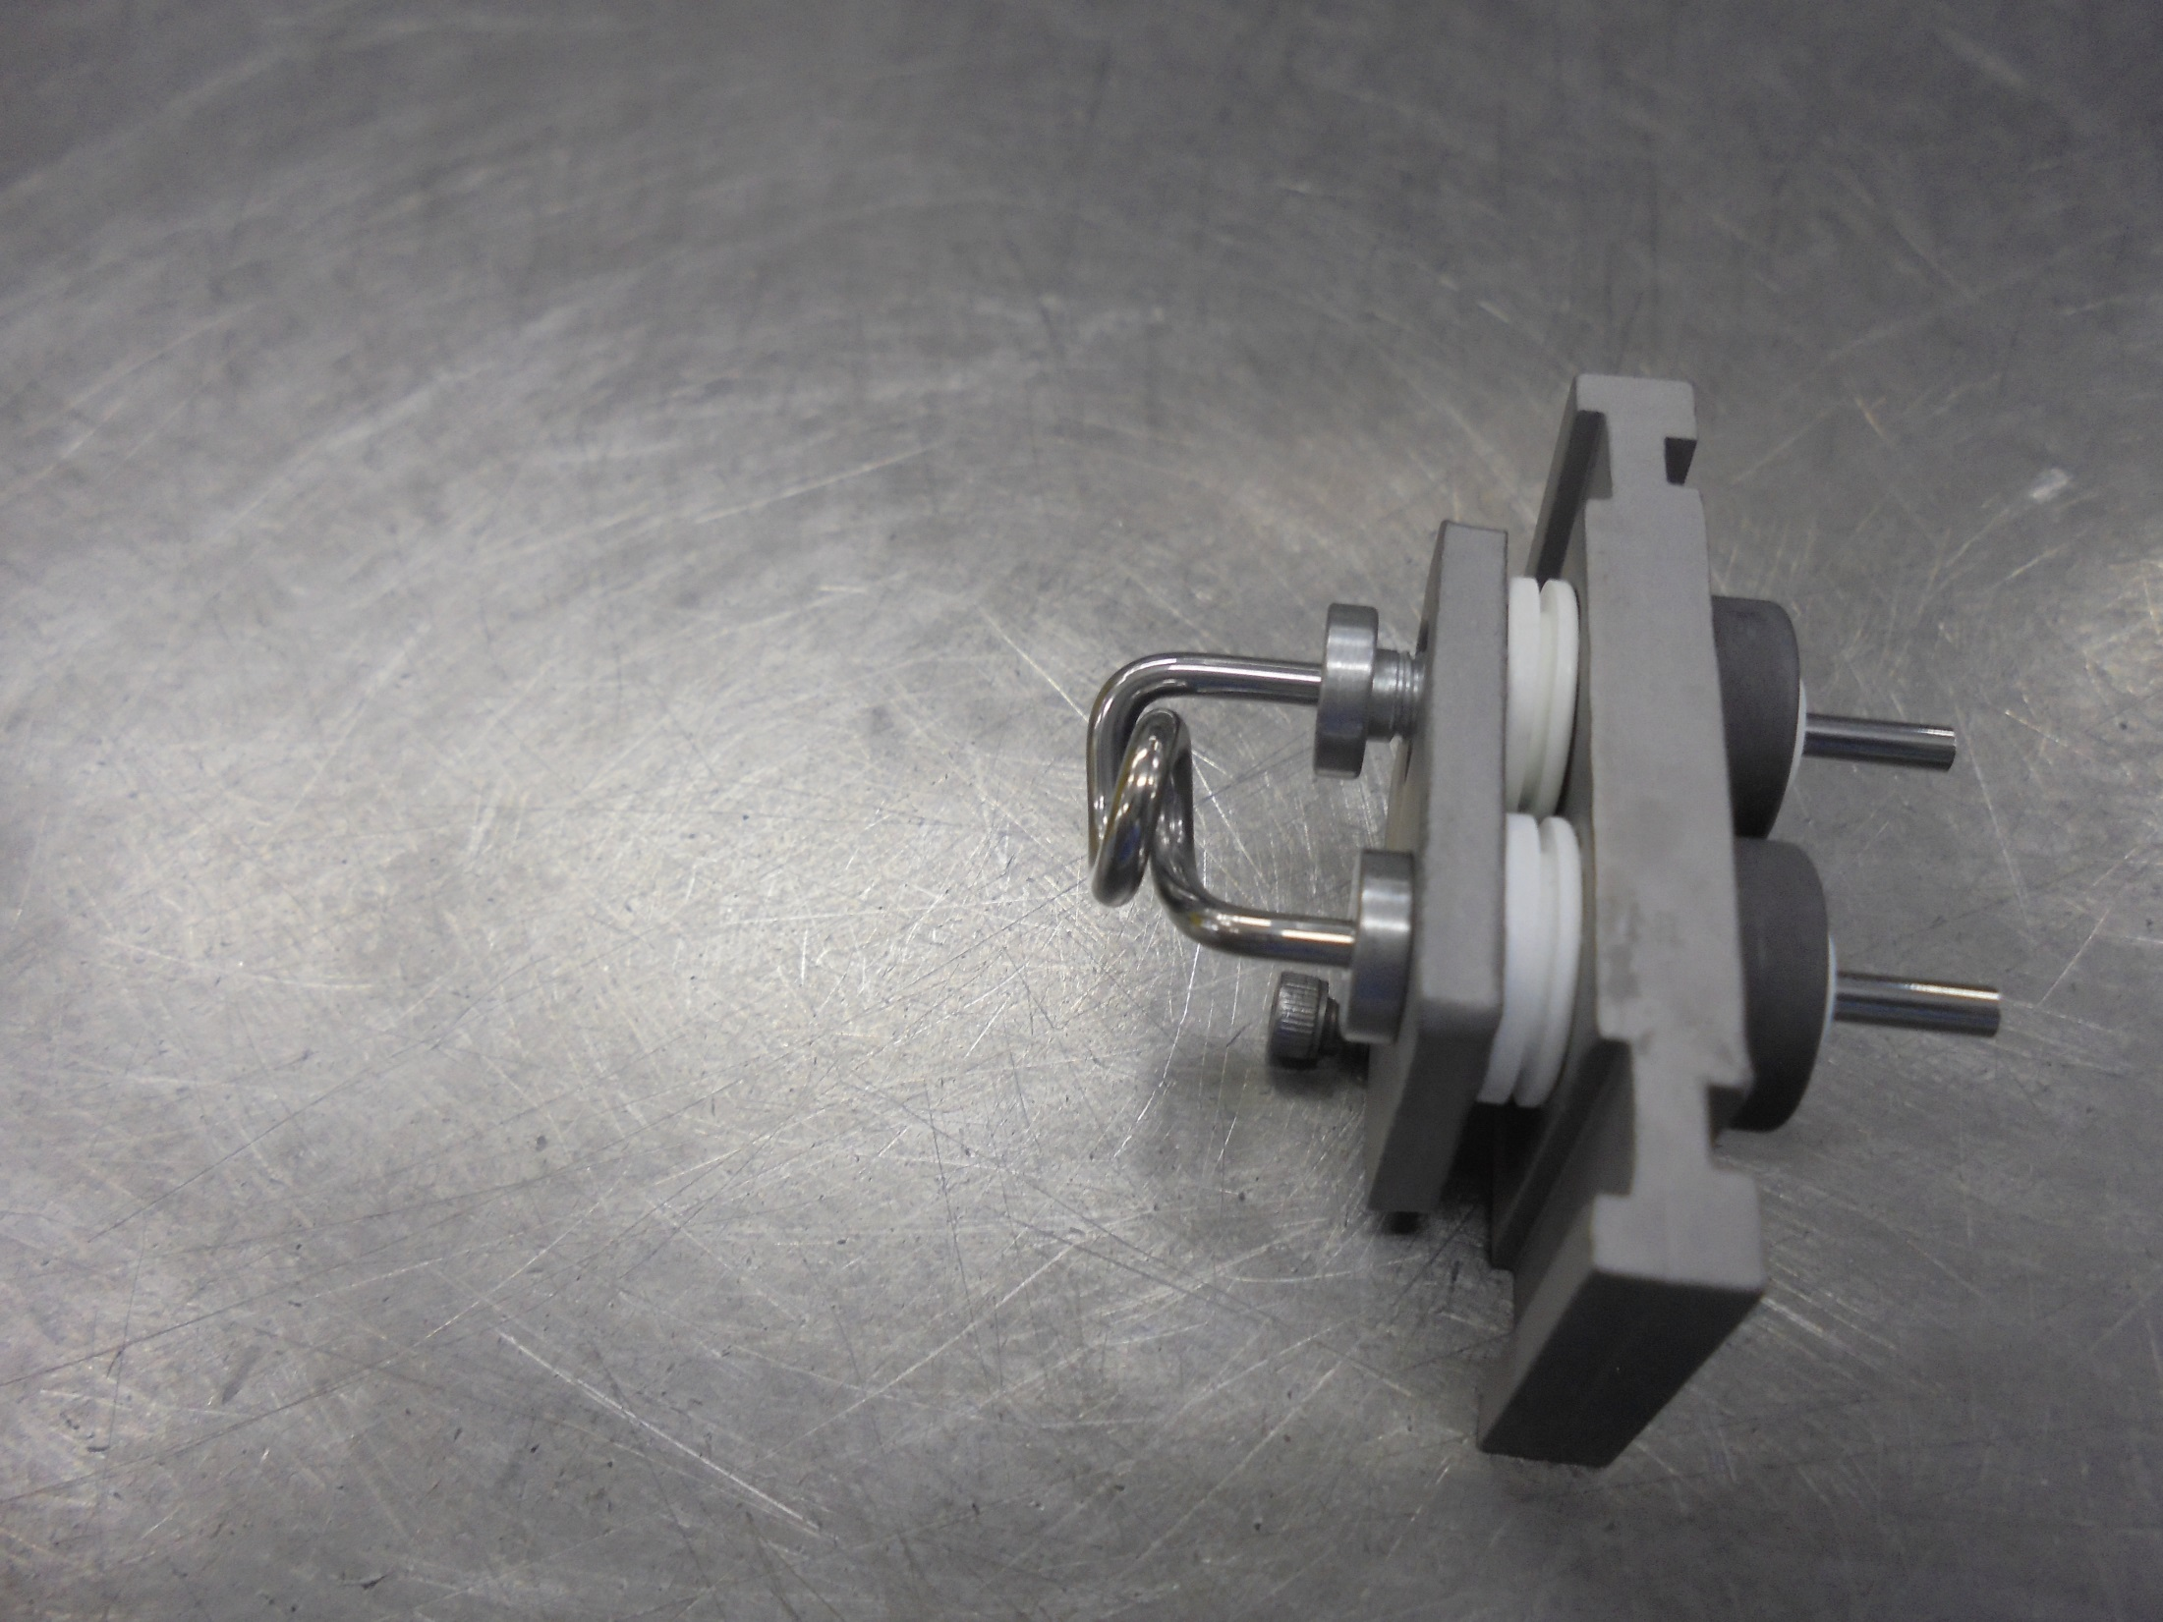
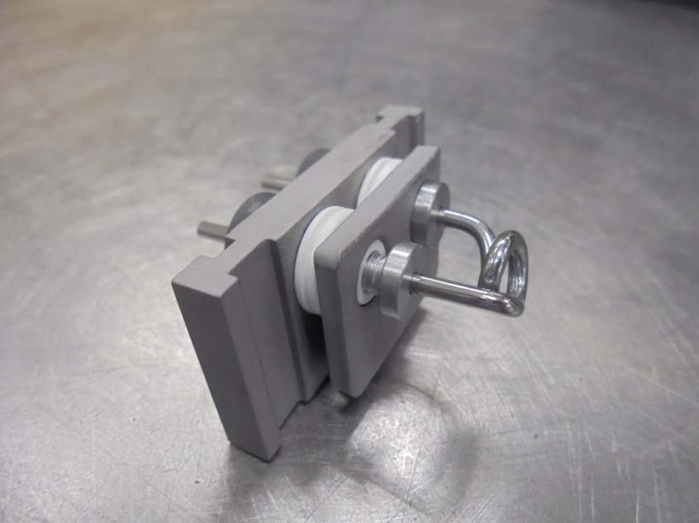
FILAMENT END Assembly

Slide 23
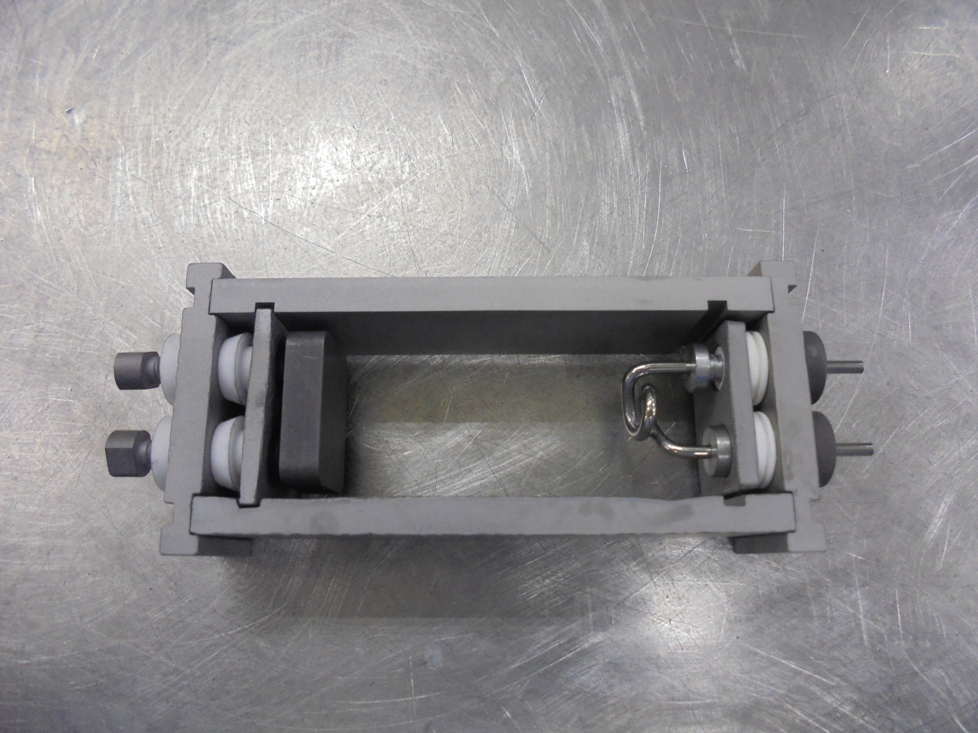
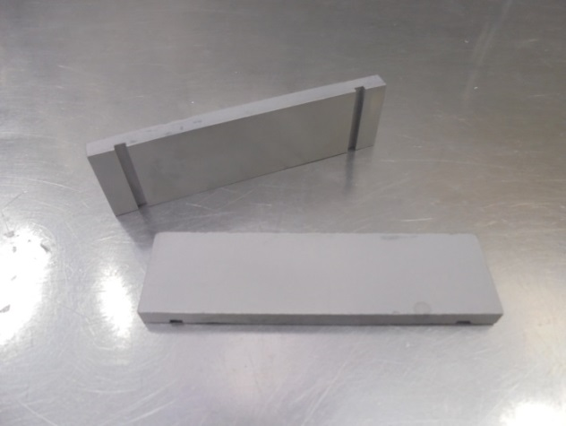
SIDE PLATES

Slide 24
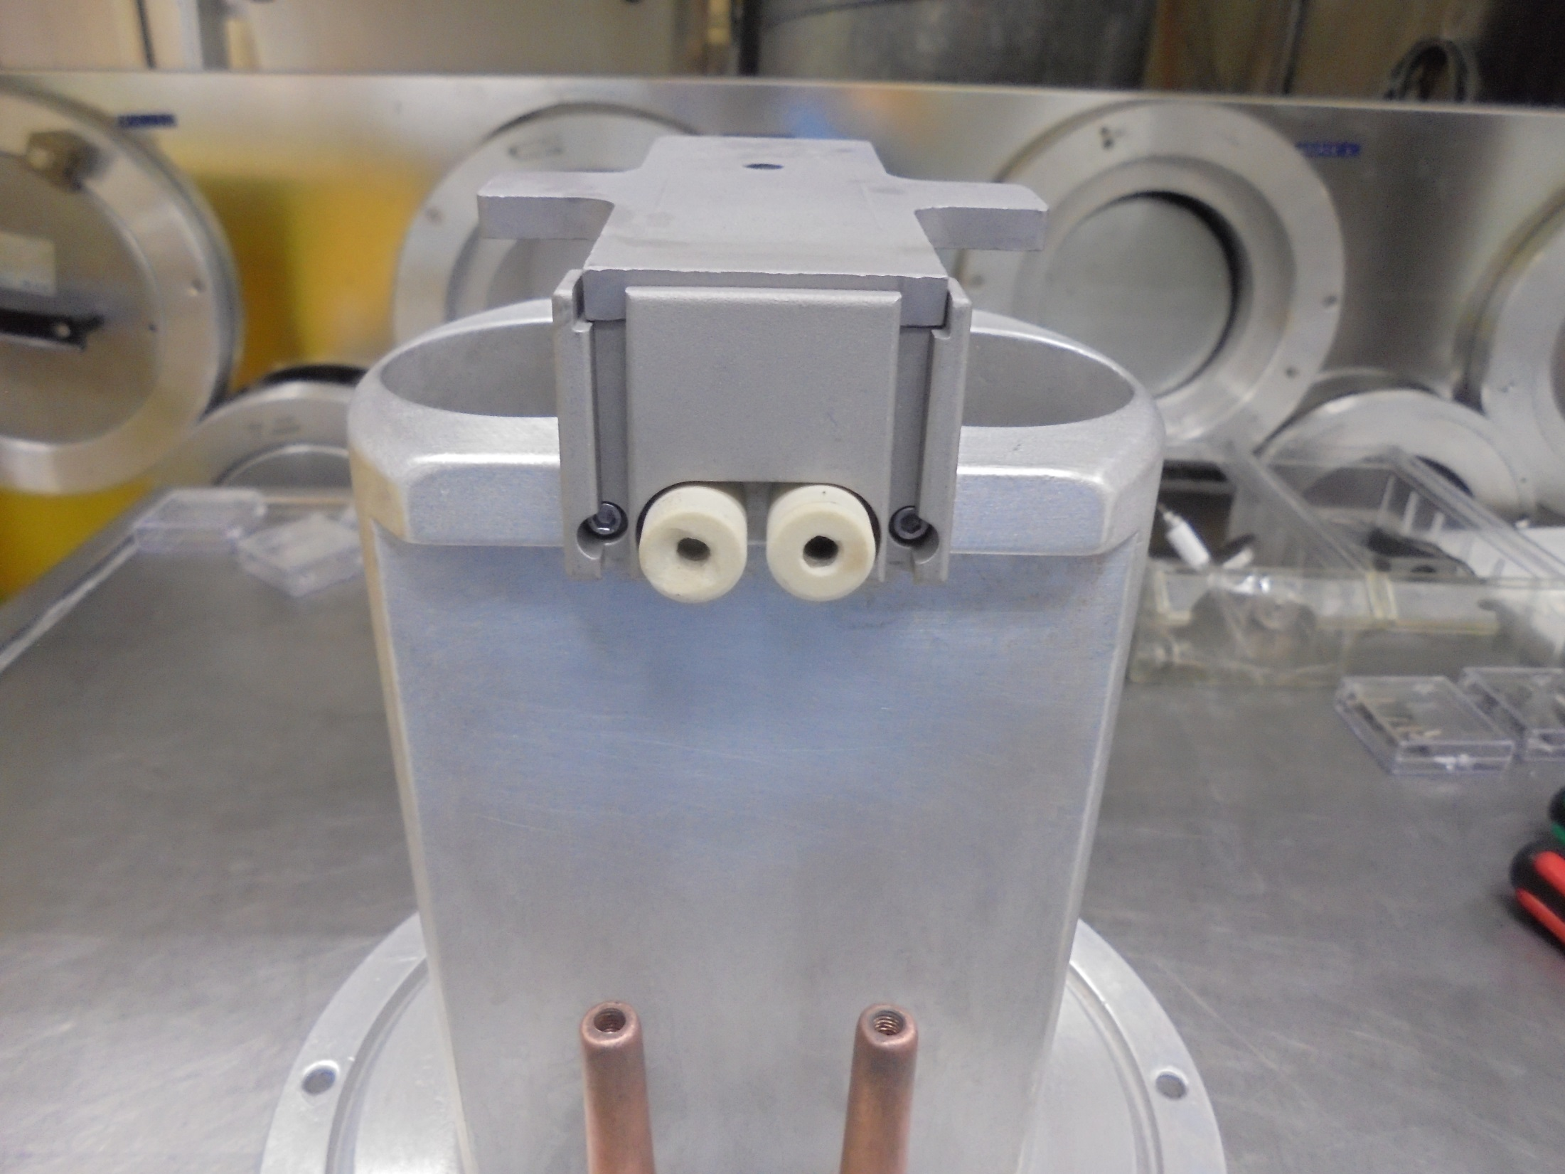
*Install The FILAMENT CLAMP Insulator…

Slide 25
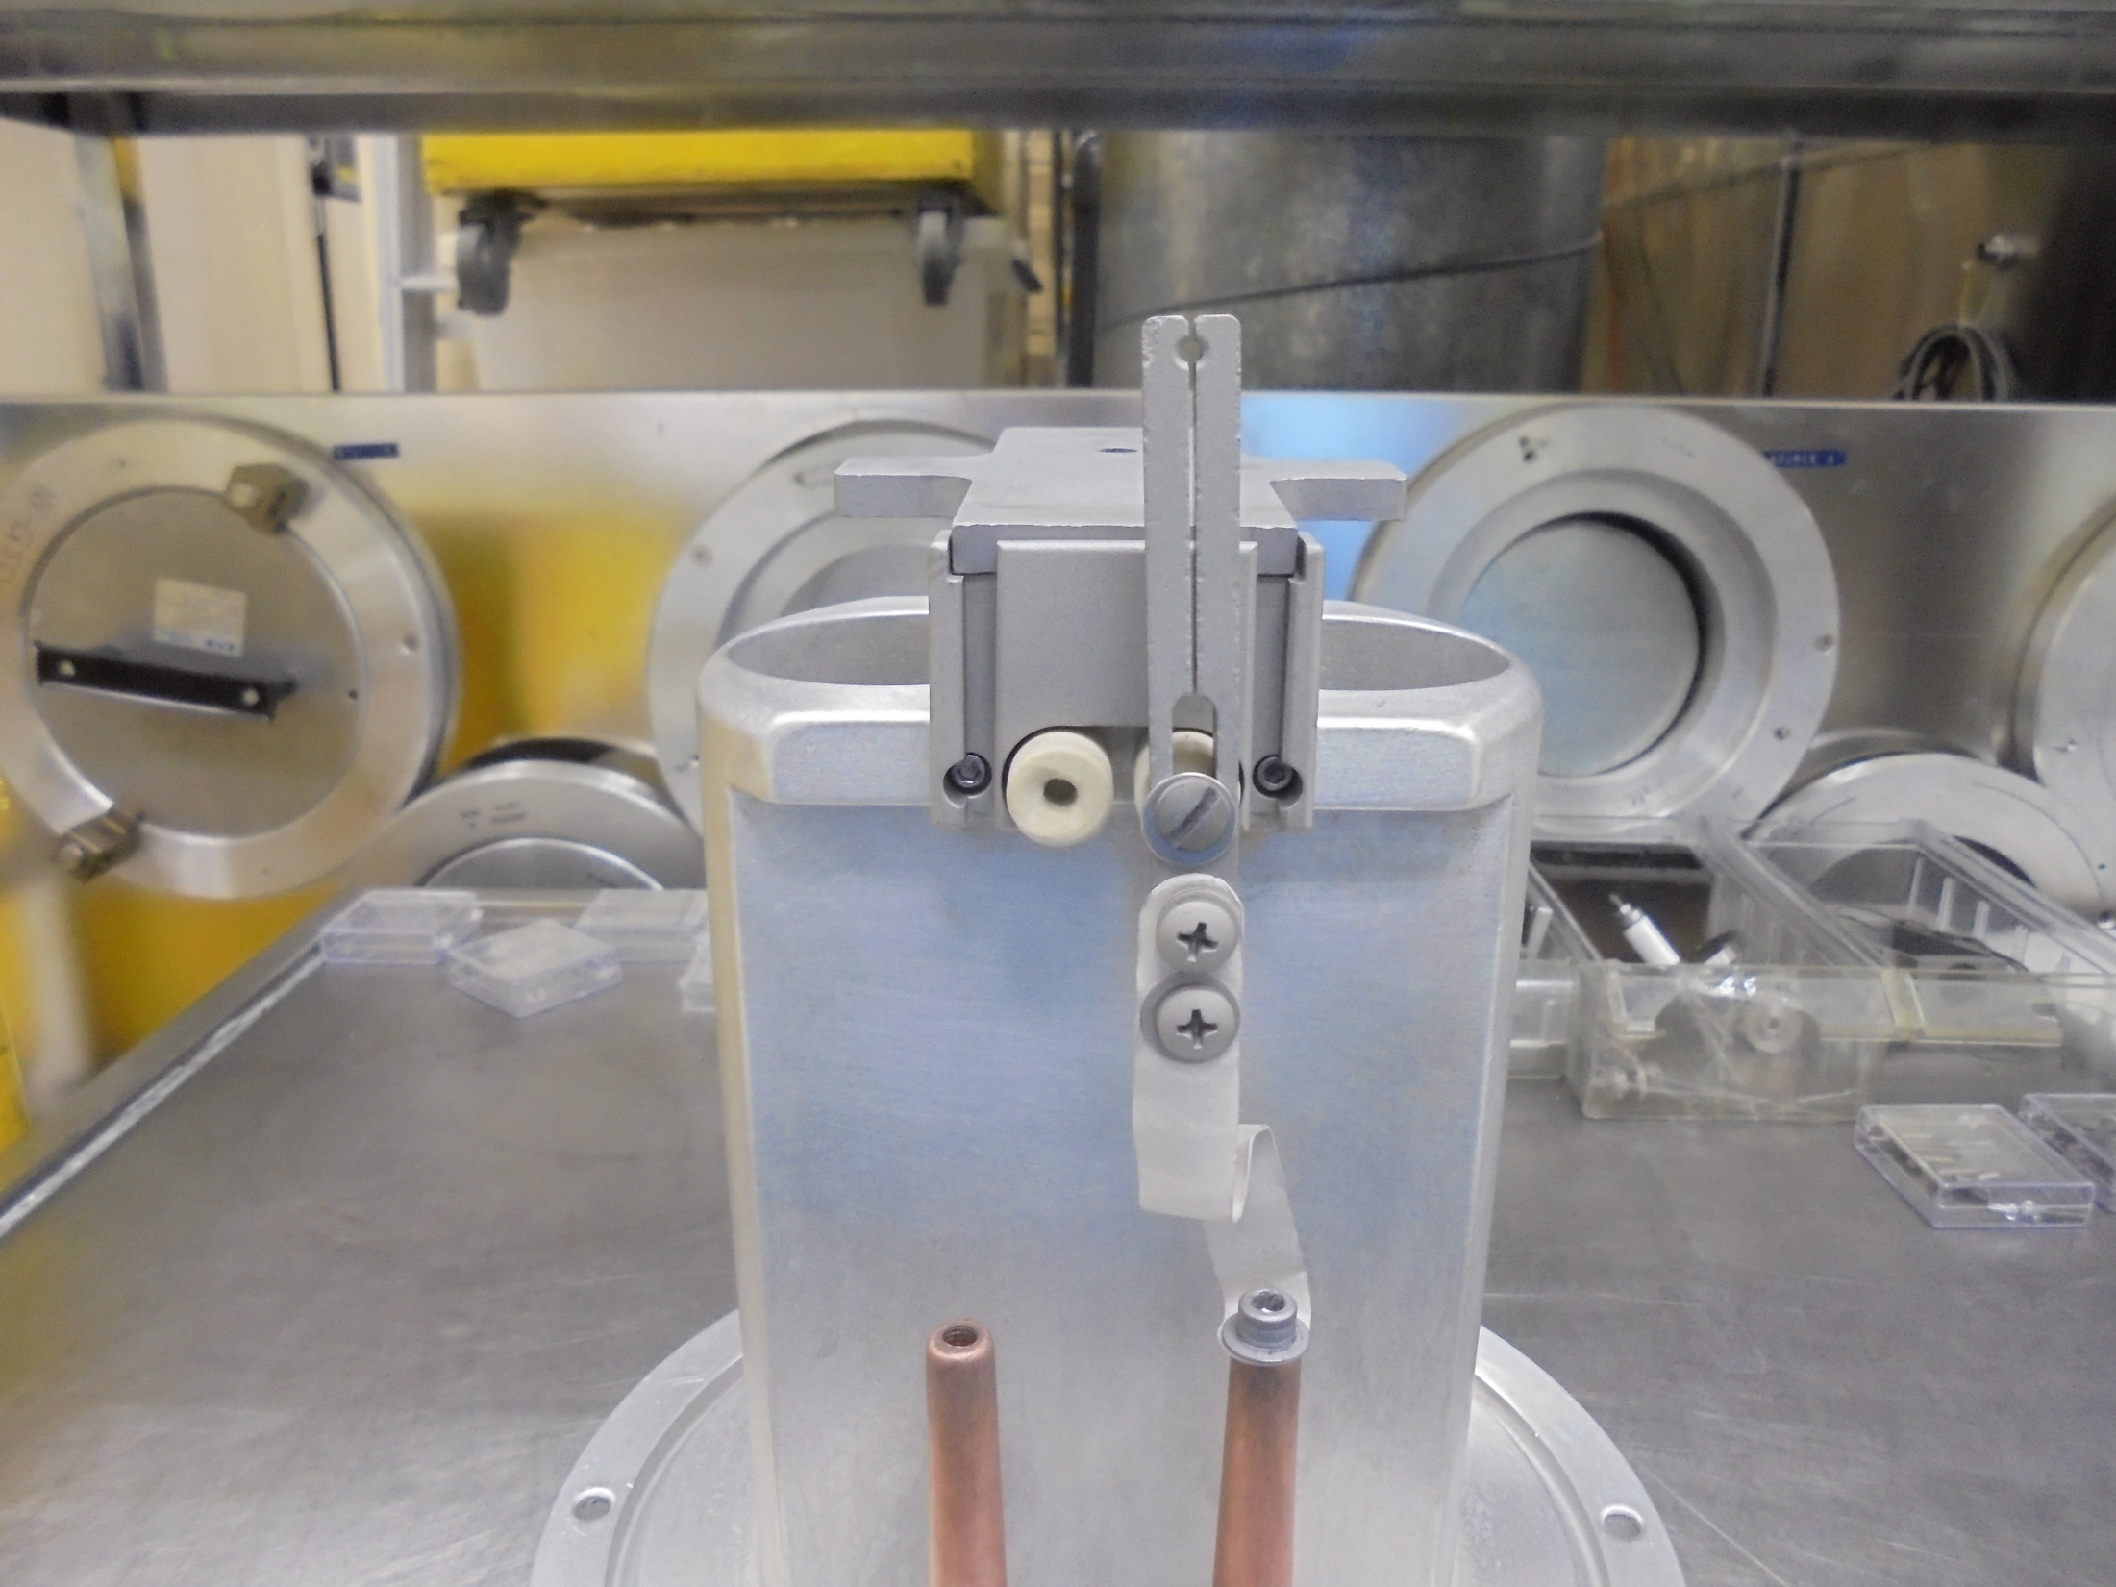
*Install FILAMENT CLAMP…

Slide 26
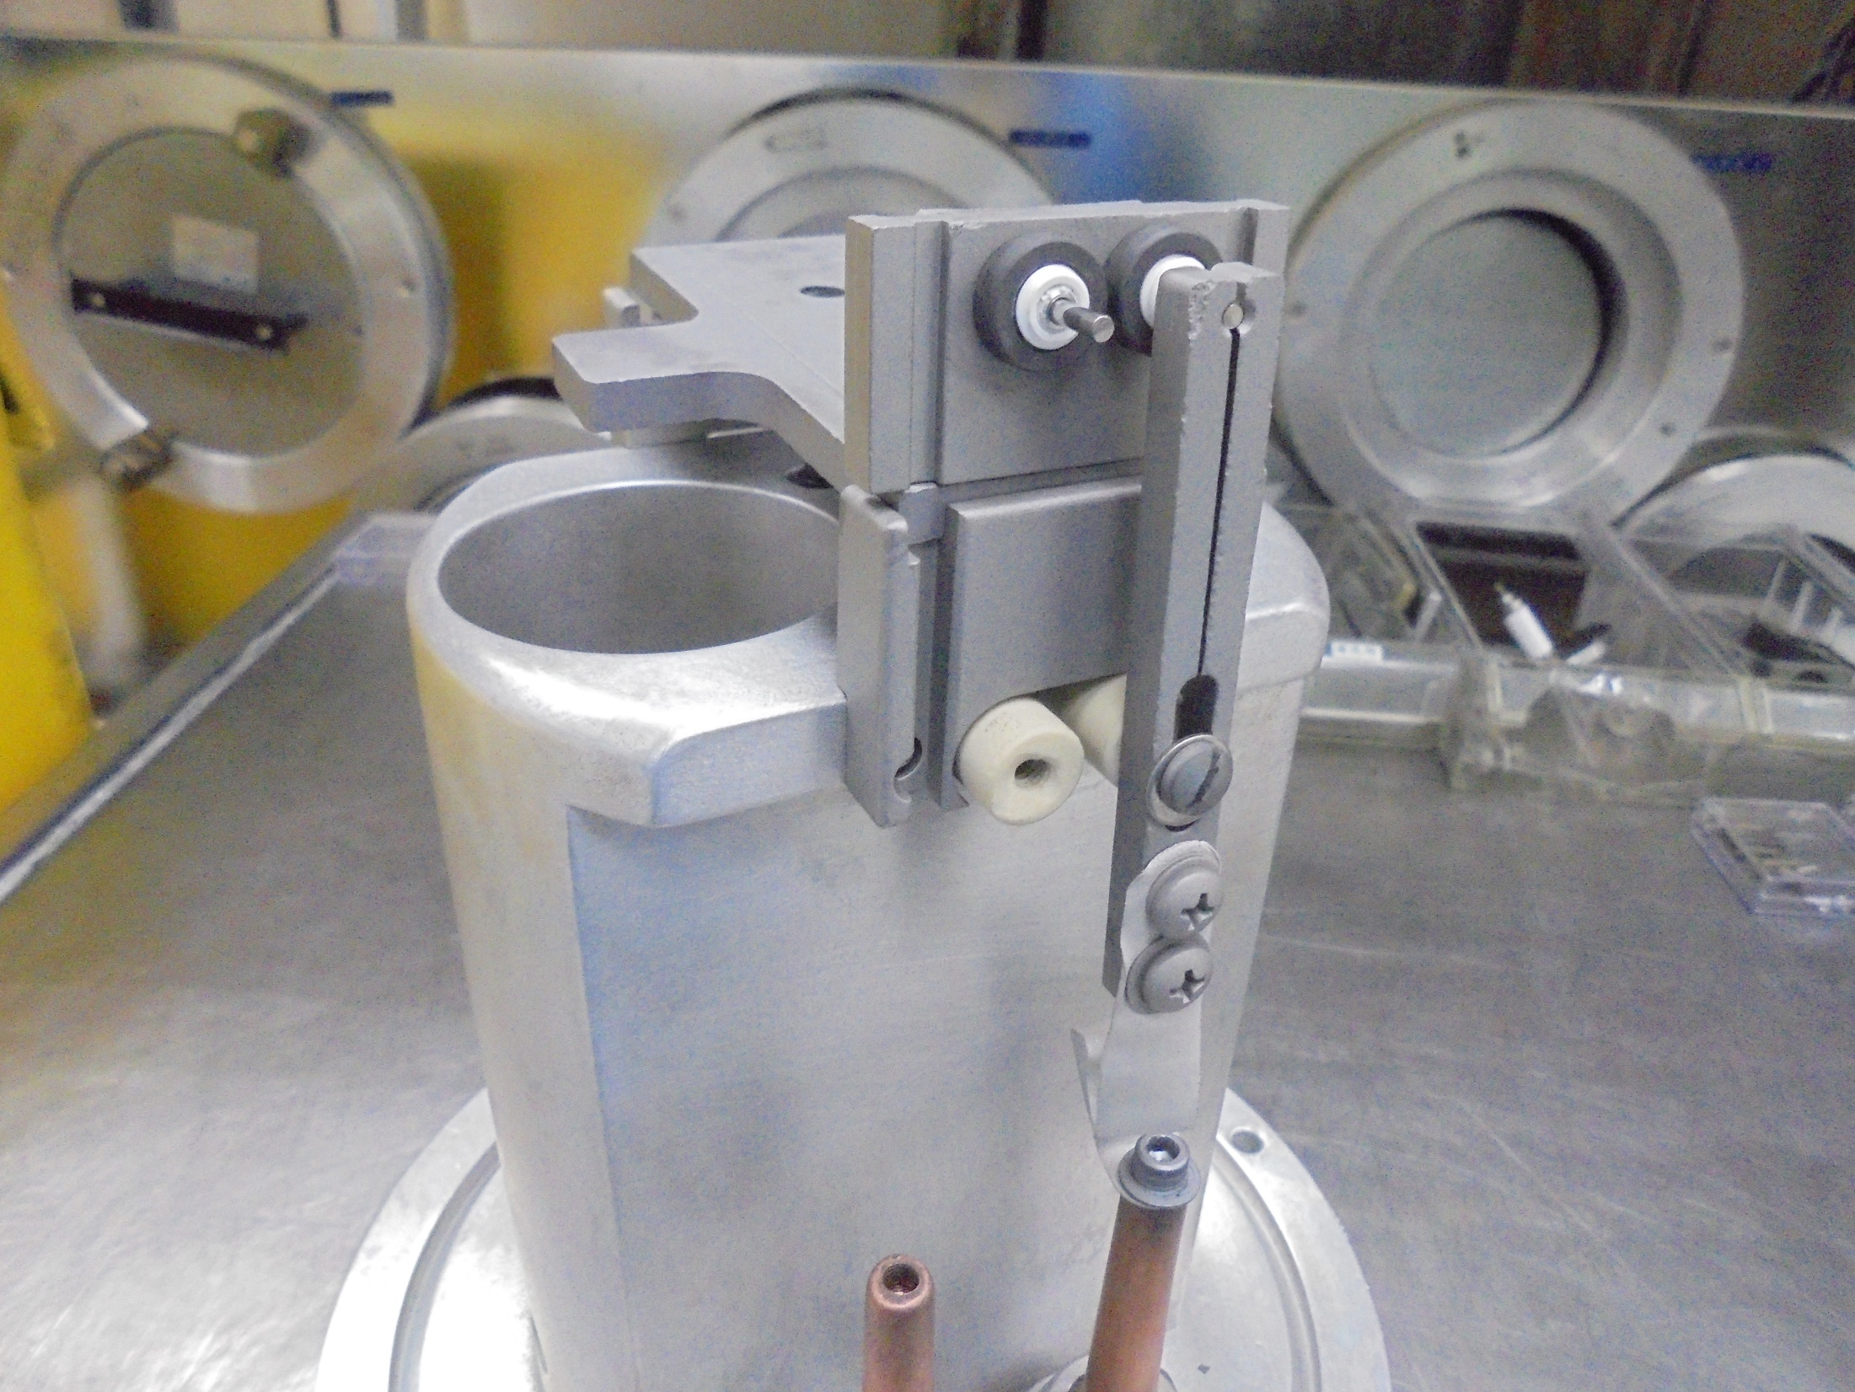
*Insert The FILAMENT
[FILAMENT END ASSY.]
On The FILAMENT CLAMP…

Slide 27
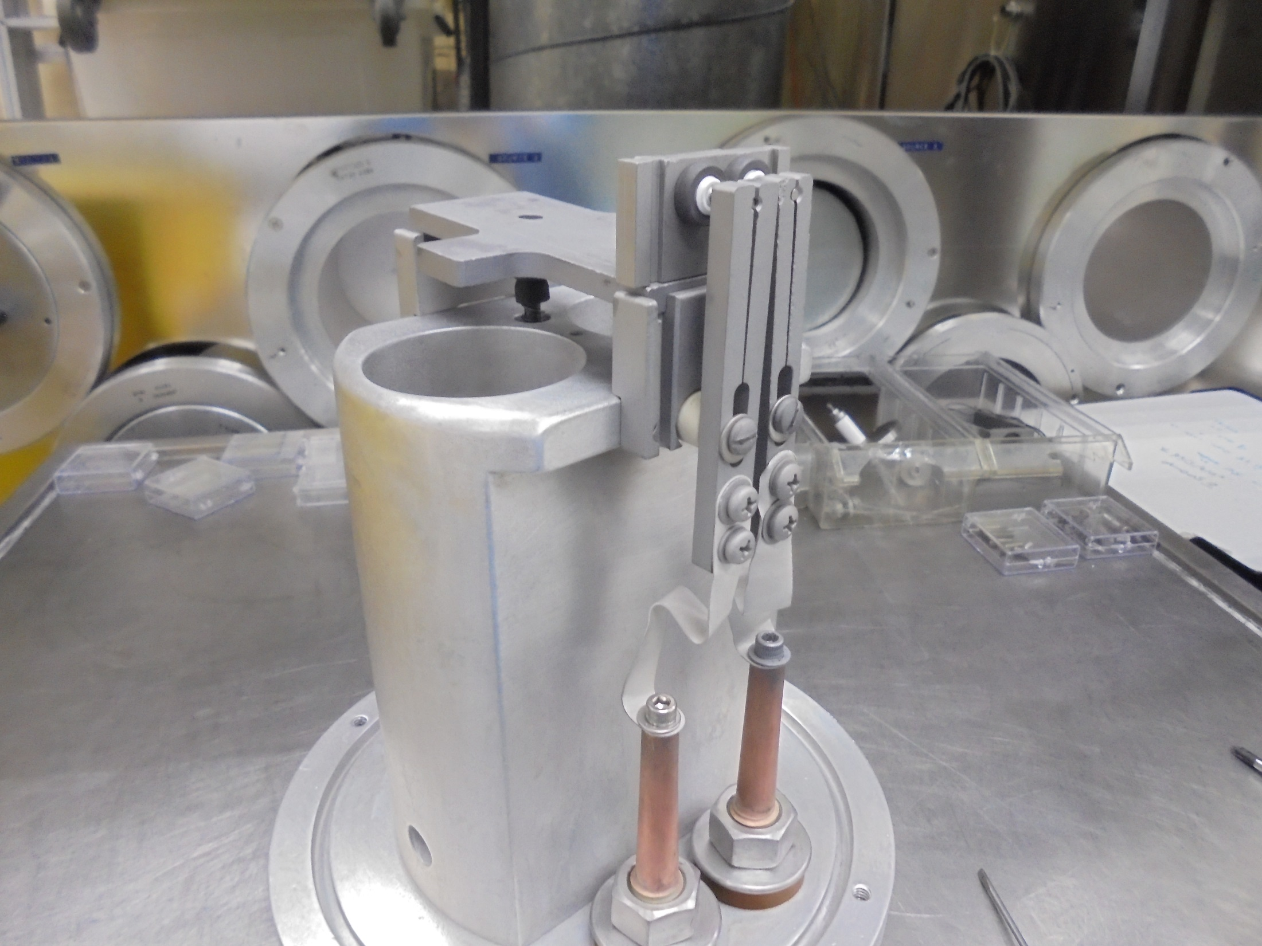
*Install The Other
FILAMENT CLAMP…

Slide 28
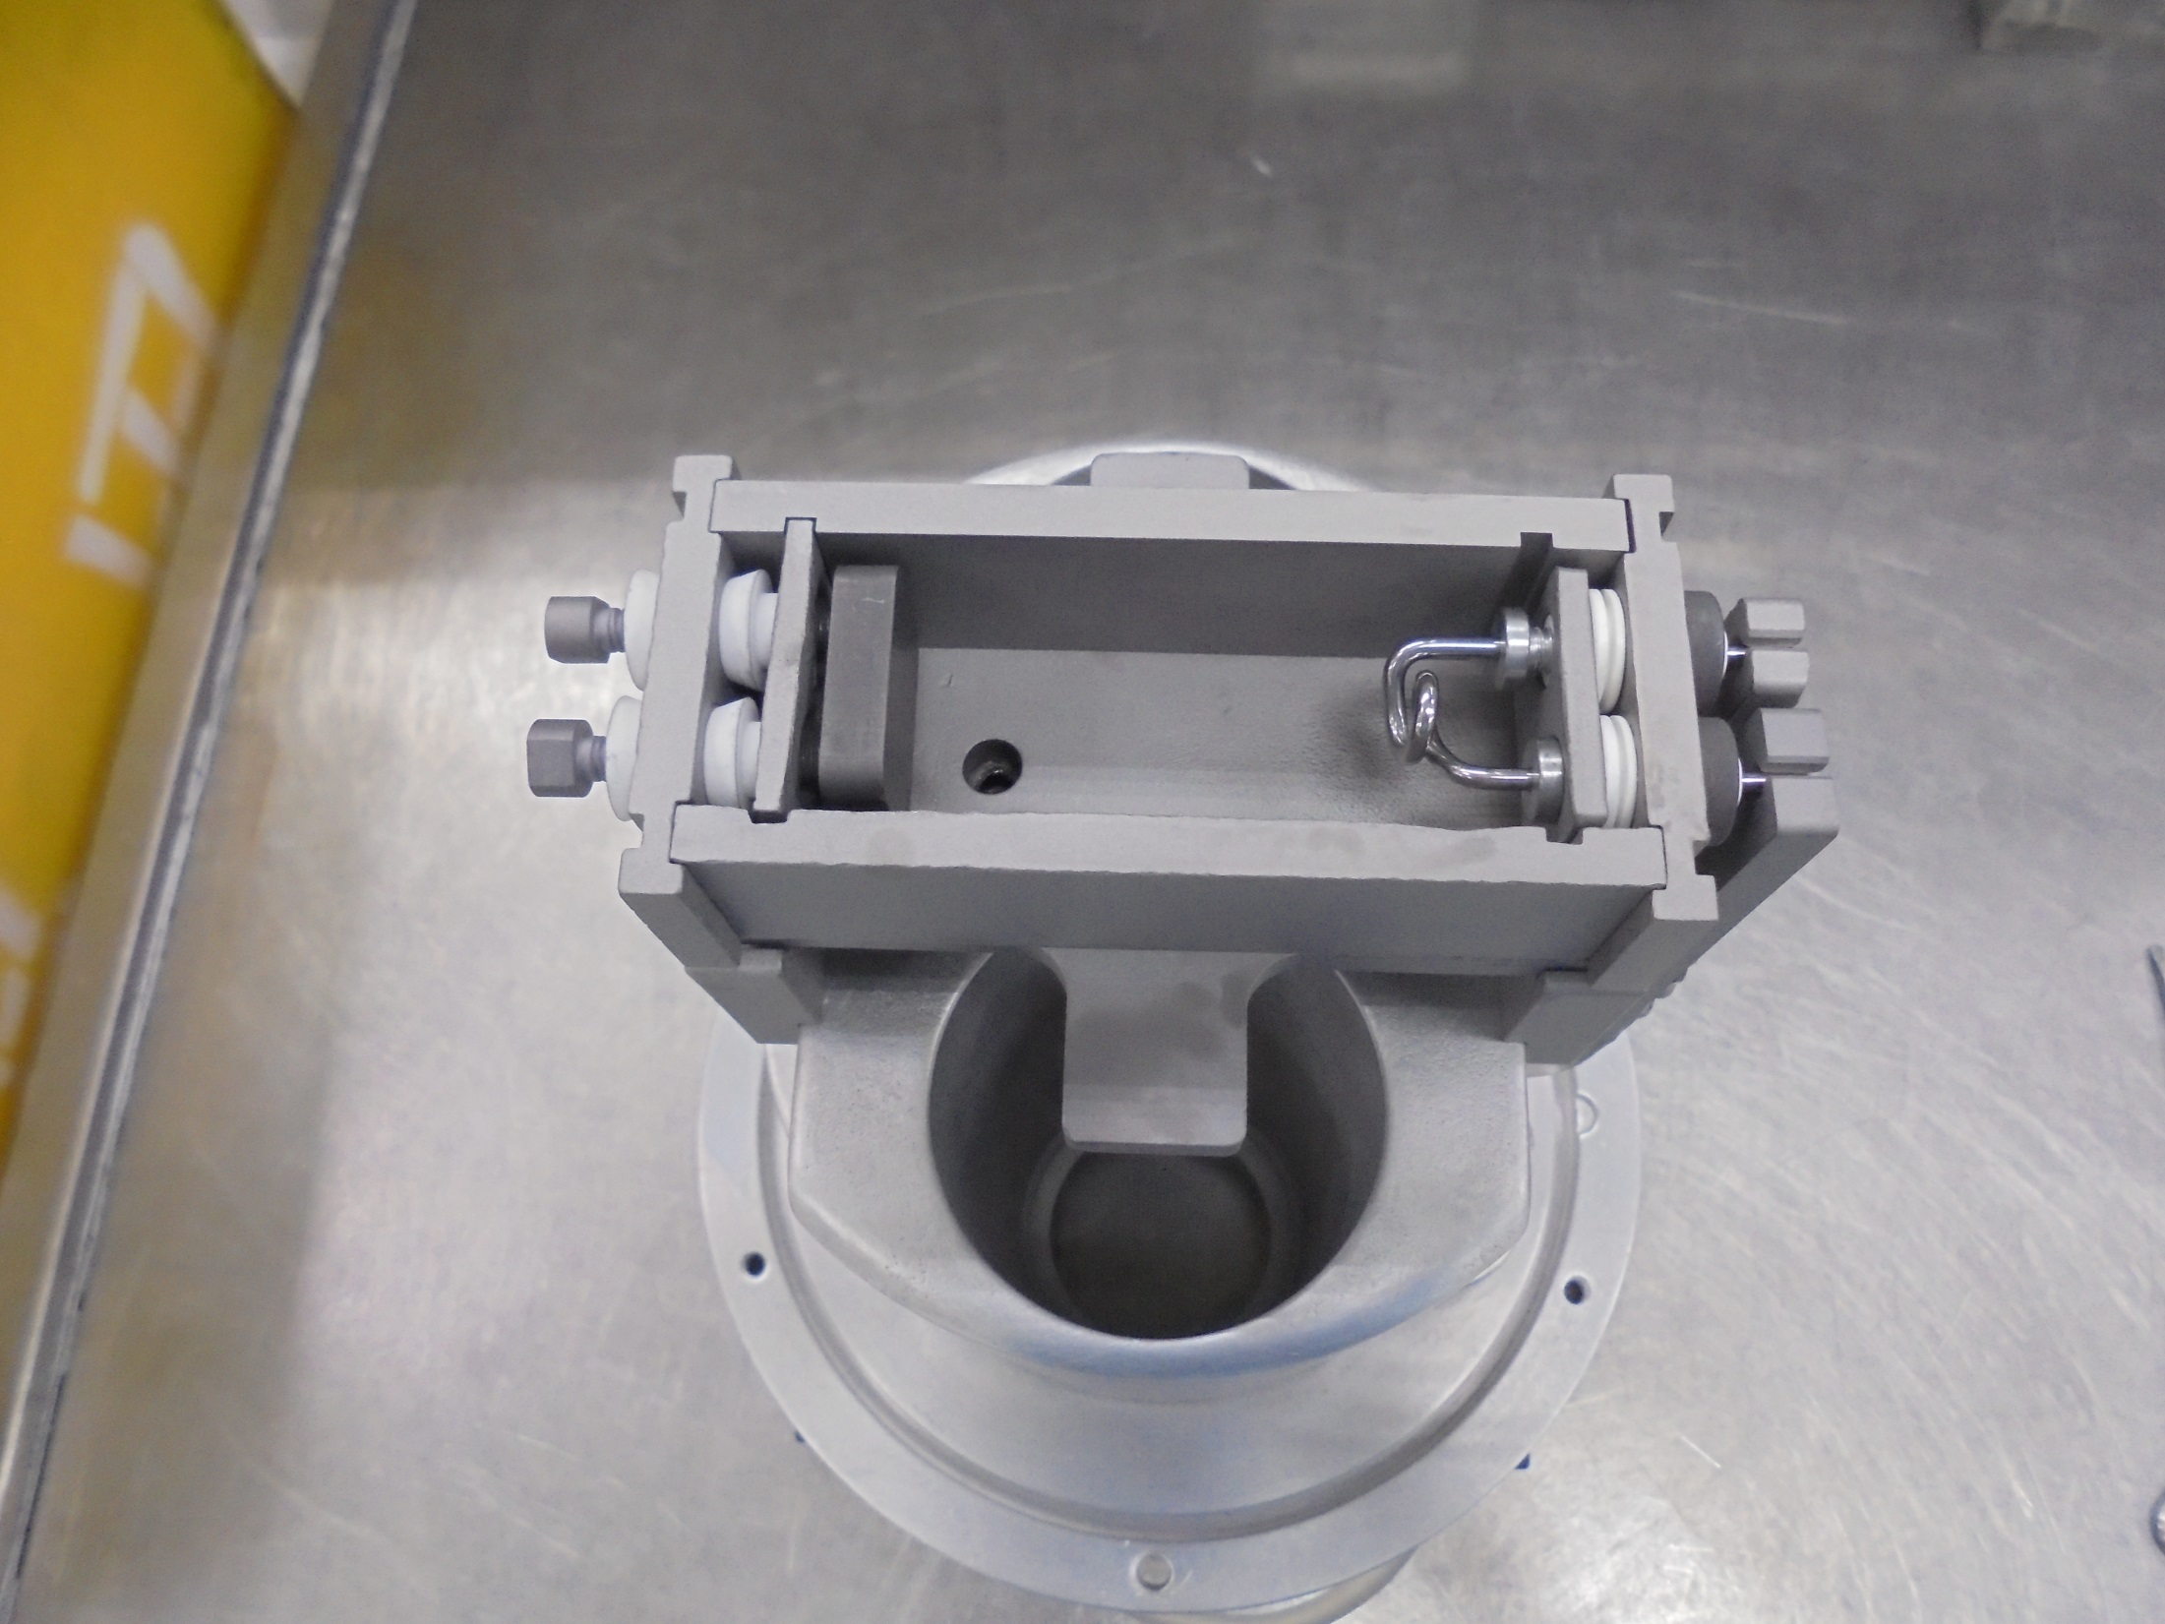
ARC CHAMBER
*Install The SIDE PLATES
And REPELLER END

Slide 29
ISOLATION TEST

Slide 30
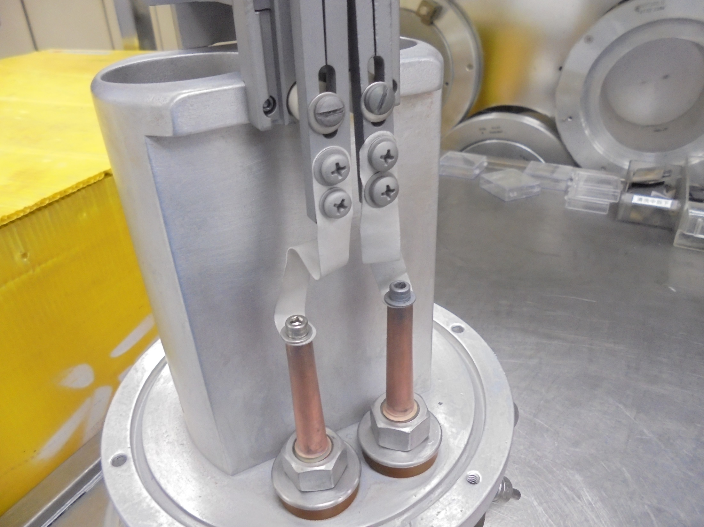
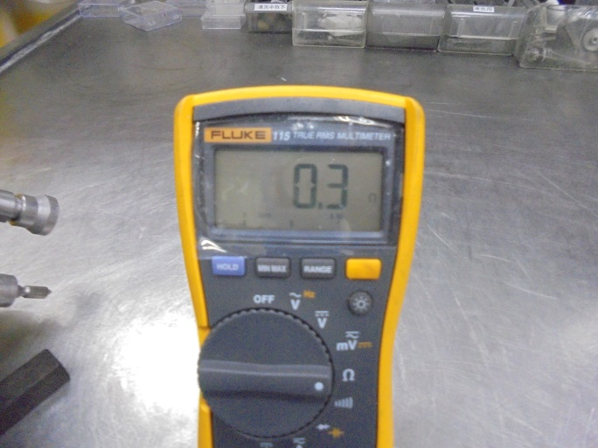
FILAMENT
to
FILAMENT
VTM Reading

Slide 31
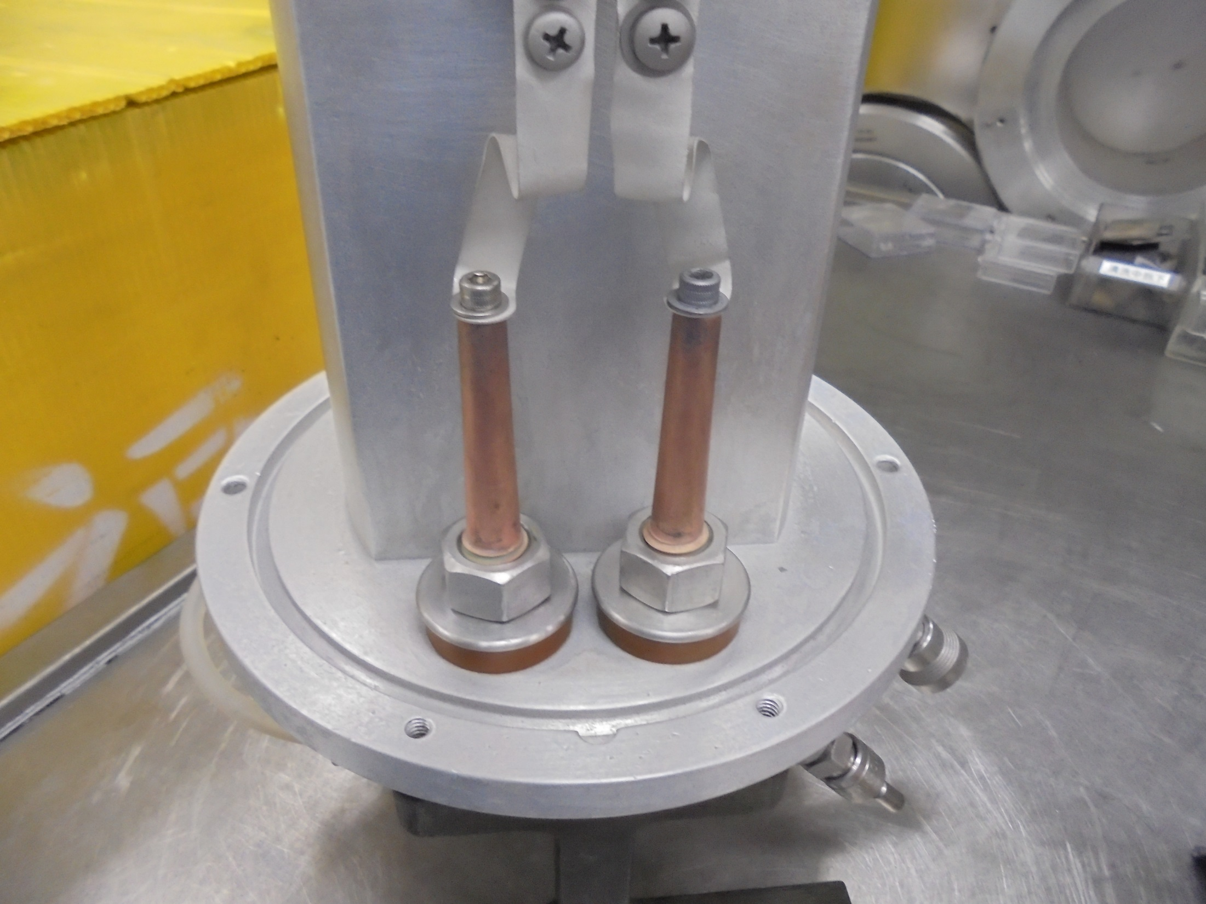
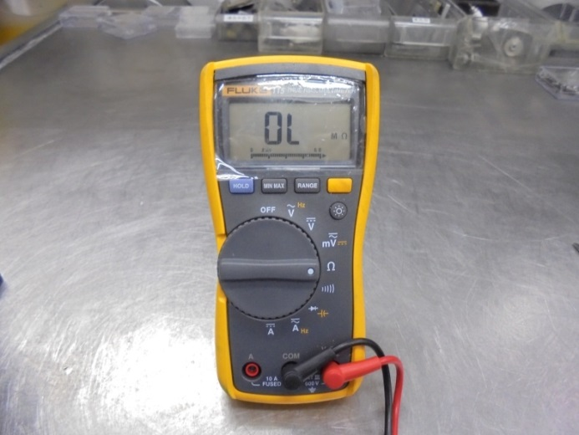
FILAMENT
to
SOURCE BODY
VTM Reading

Slide 32
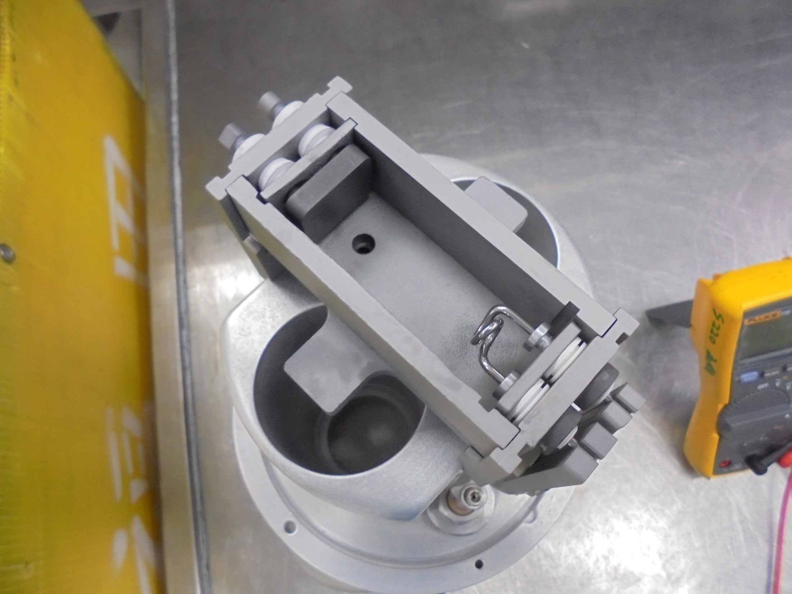

VTM Reading
REPELLER SCREW
to
REPELLER SHIELD

Slide 33
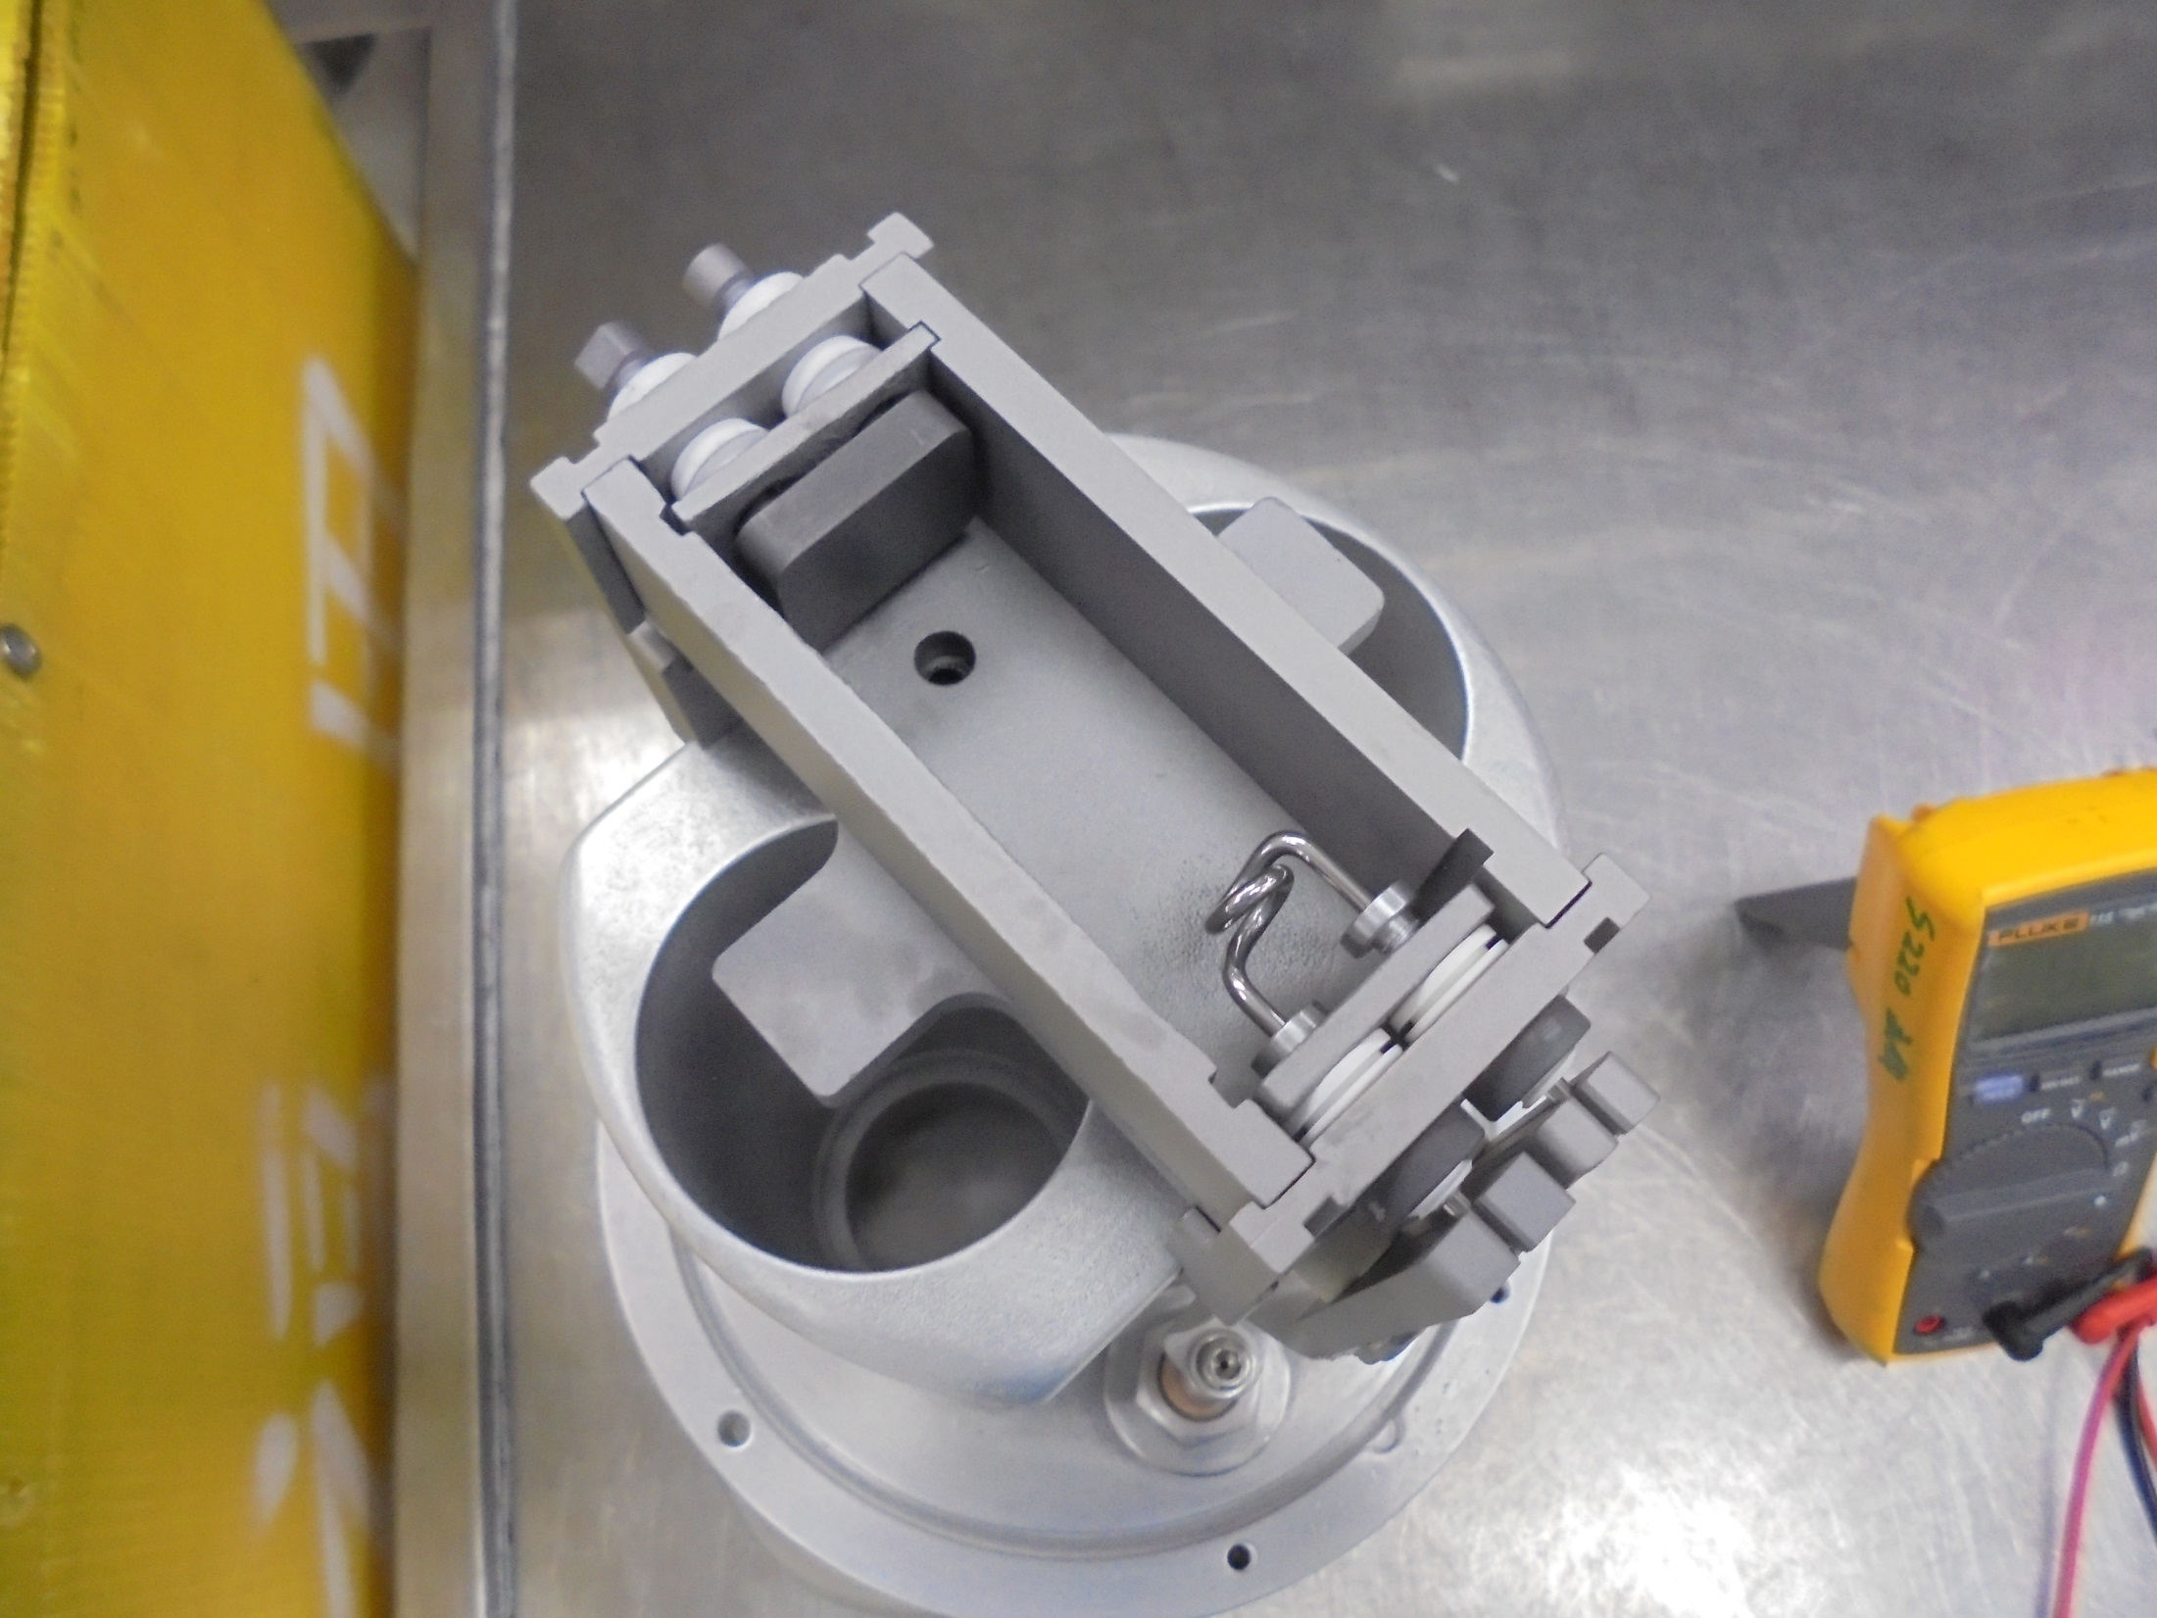

VTM Reading
REPELLER SCREW
to
SIDE PLATE

Slide 34

VTM Reading
FILAMENT END
to
FILAMENT SHIELD

Slide 35
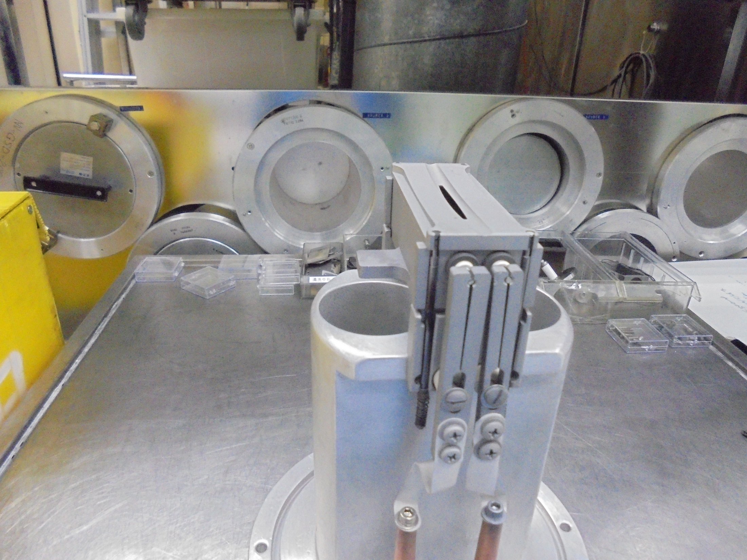
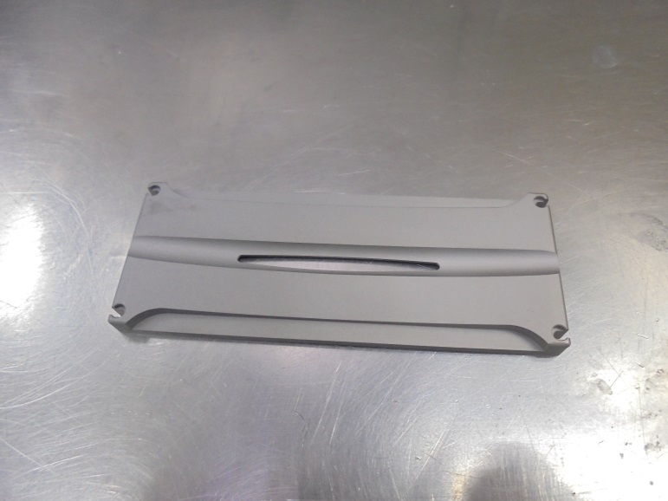
ARC SLIT / FACE PLATE
*Secure With Retainer Pins

Slide 36
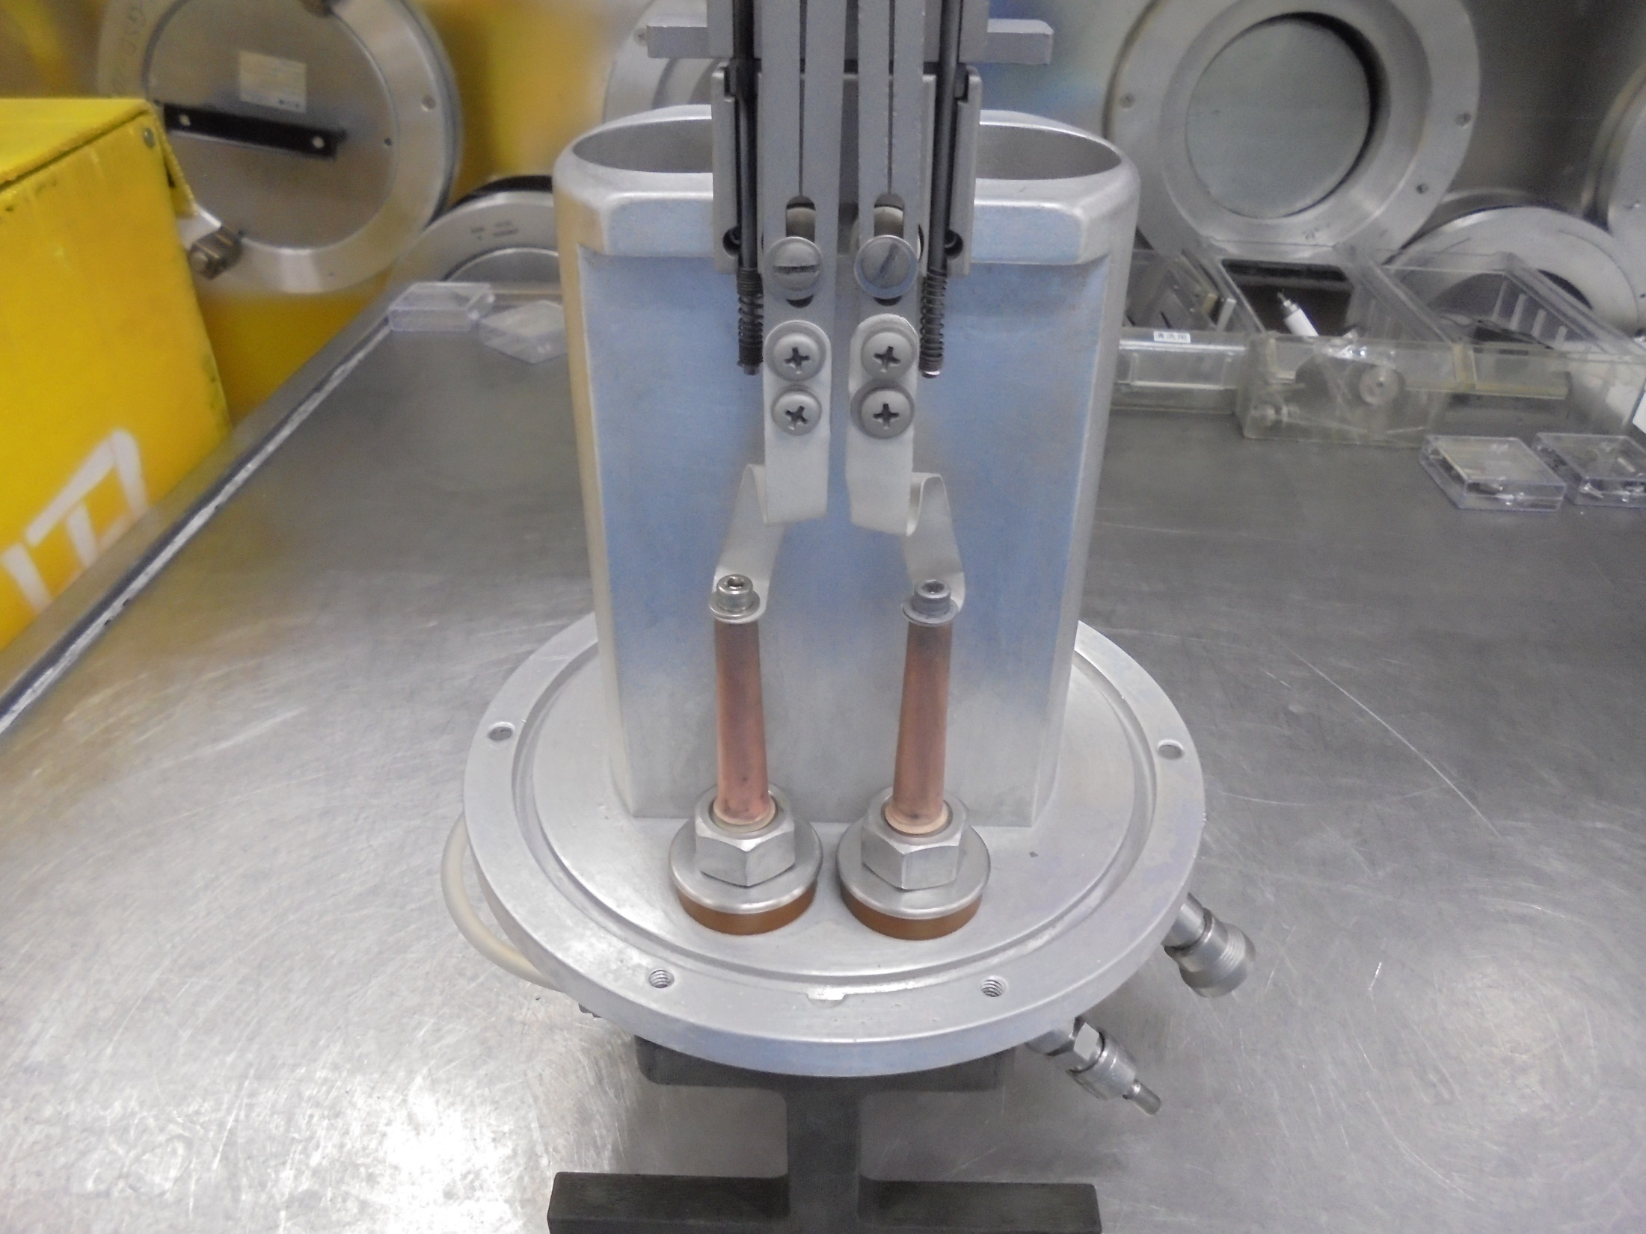
*Clean The O-RING Slot With IPA

Slide 37
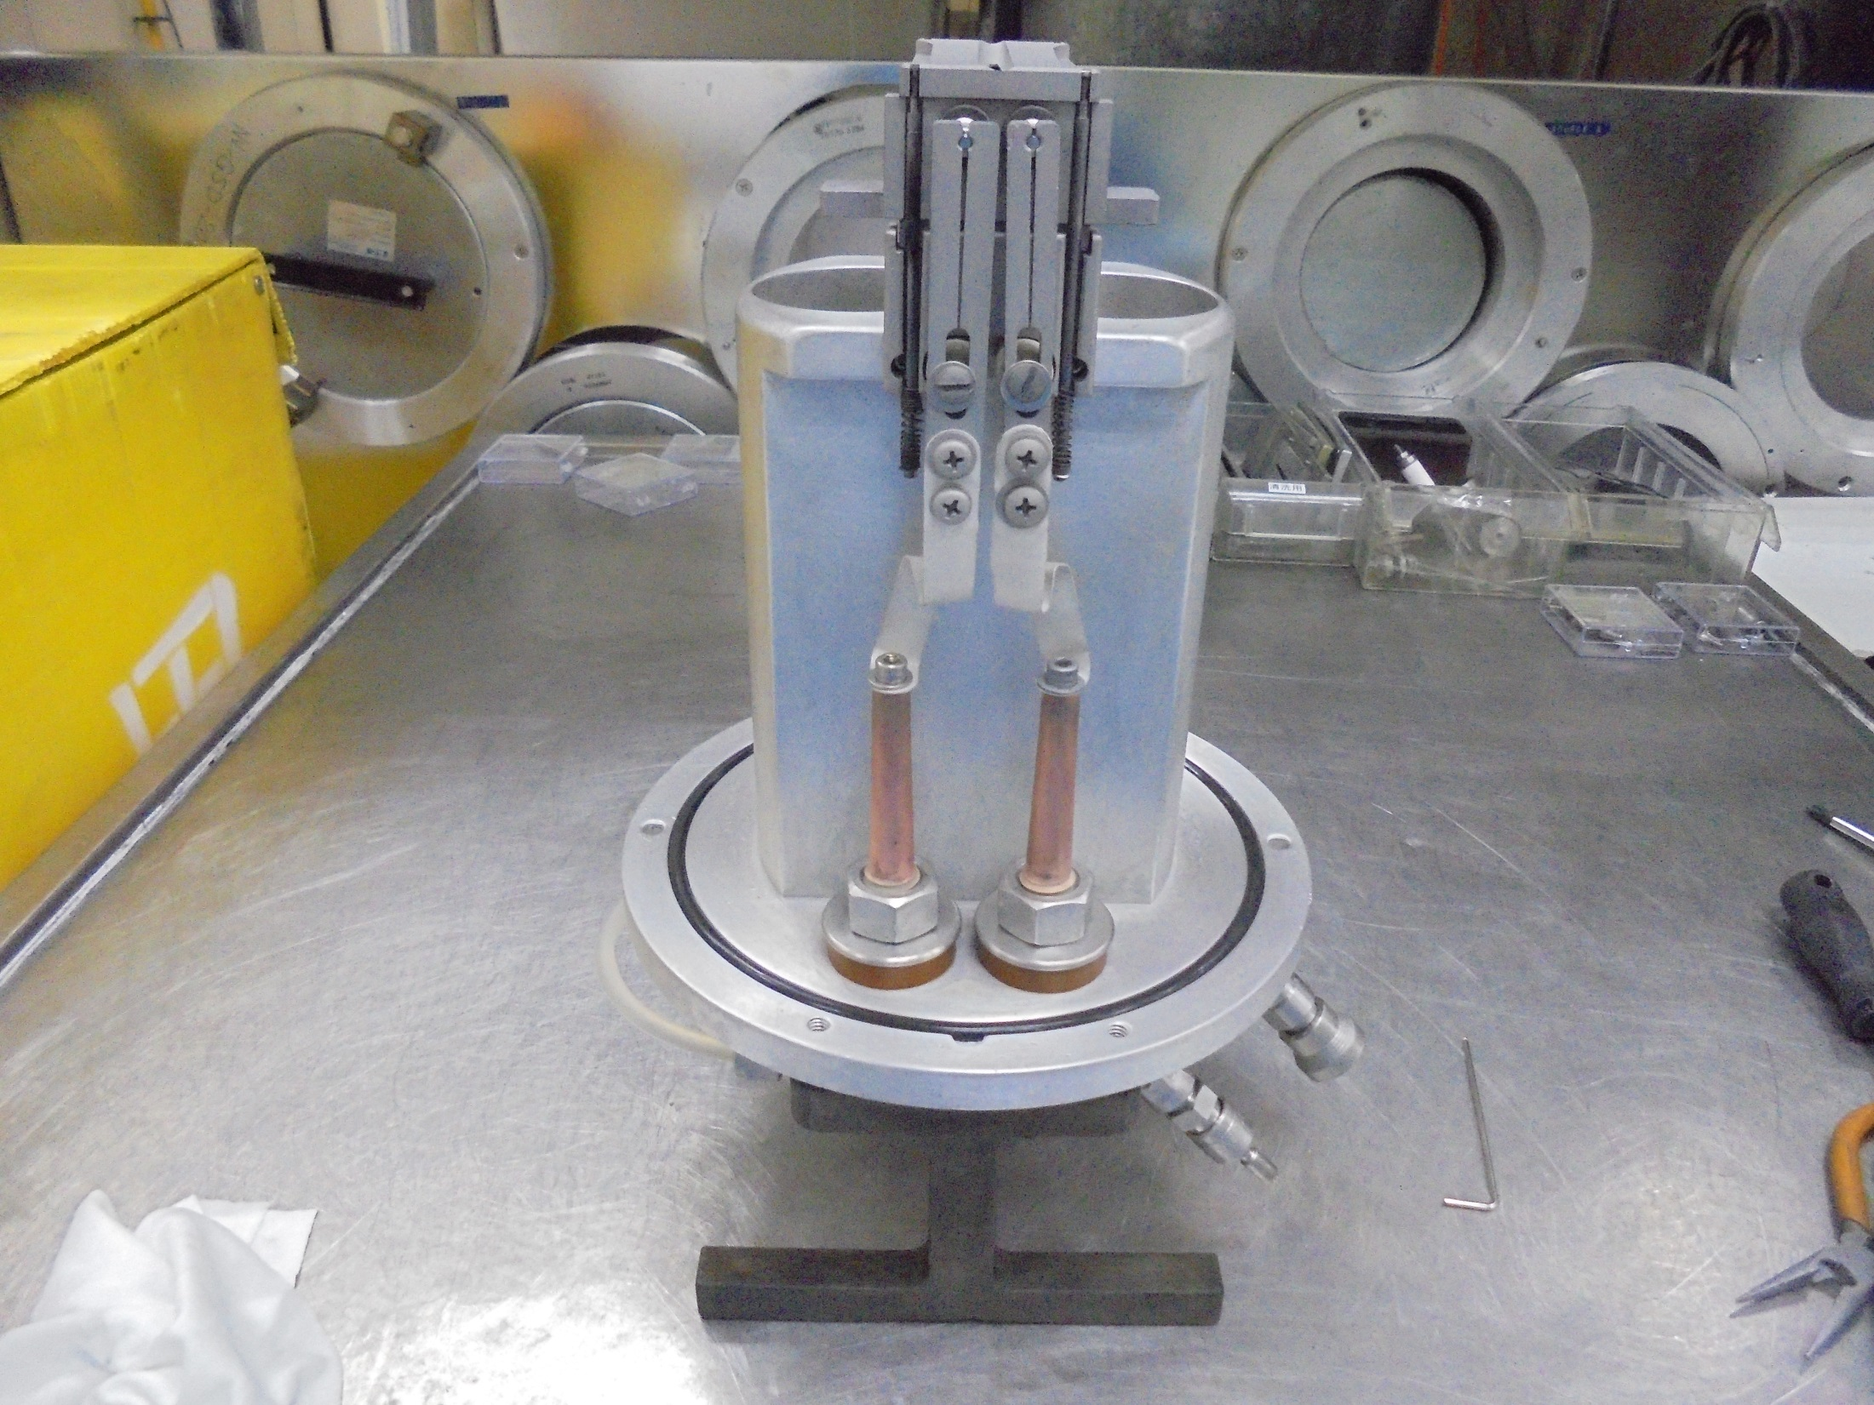
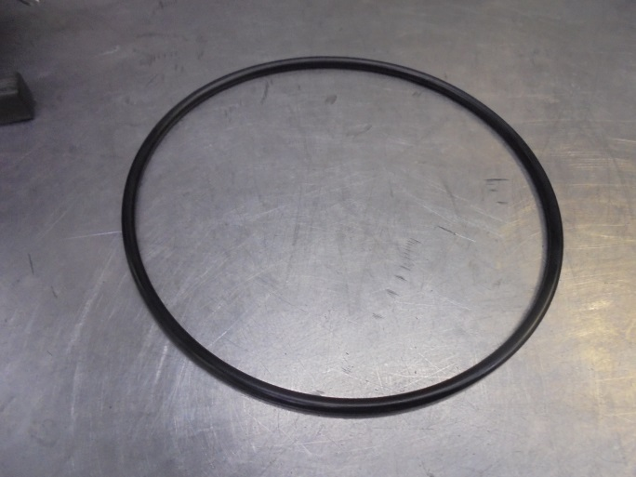
*Clean And Check
The O-RING Then
Install..

Slide 38
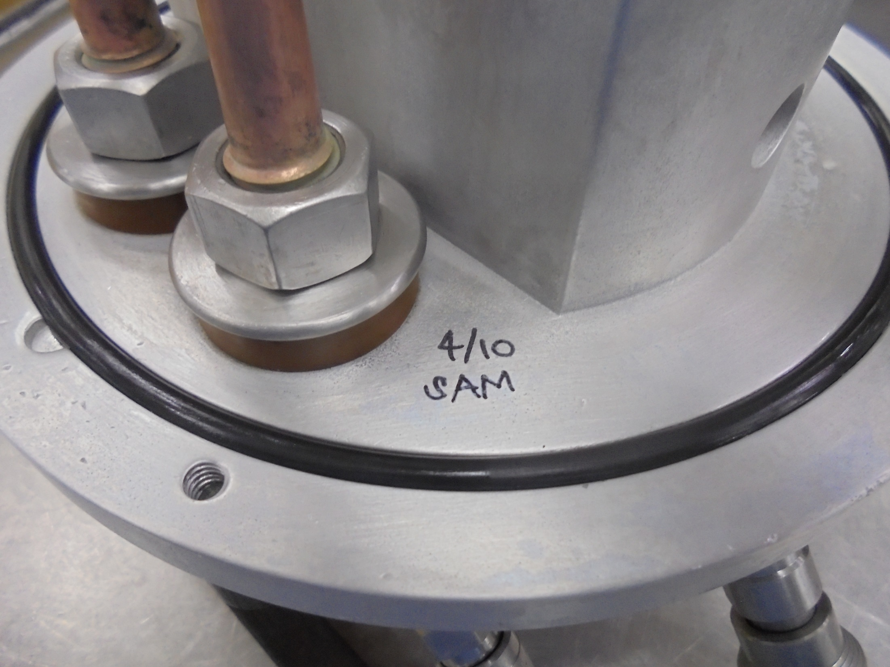
Sign NAME And DATE.
Maintenance Done.

Slide 39
-END-

